Slide 1
Insurance Renewal Prediction
PGCP AIML Cohort 12 - AIML_Oct_2024 - Group 12
Team
Akash Mohanty (2024AIML133)
Ishika Gupta (2024AIML088)
Namratha S Hegde (2024AIML118)
Thrilok Attota (2023AIML120)
Yaswanth Reddy Dasari (2024AIML010)
Mentor: Tapas Chakraborty

Slide 2
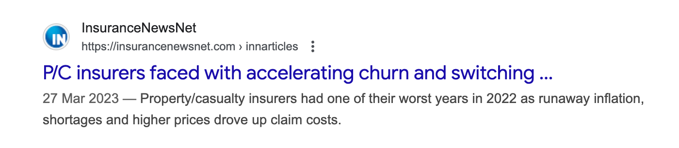

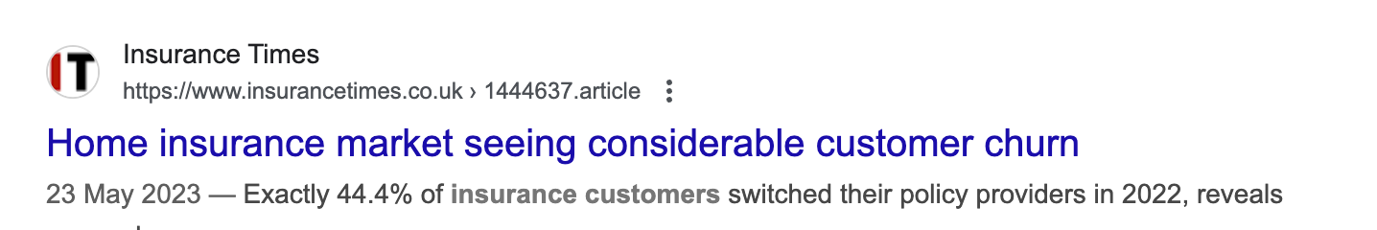
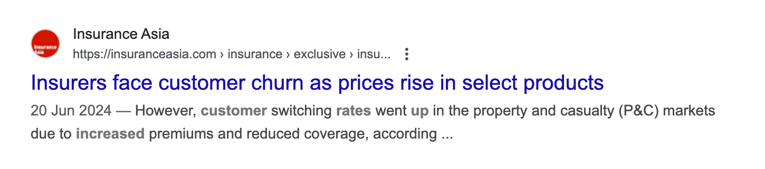
Industry Evidence

Slide 3
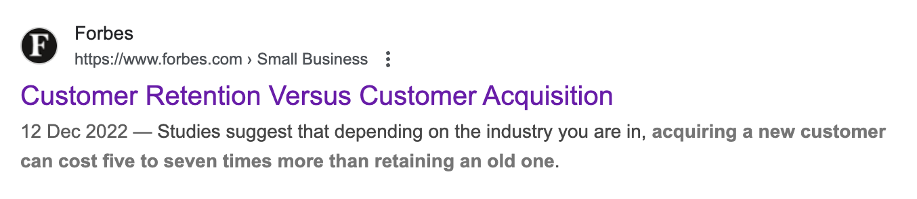
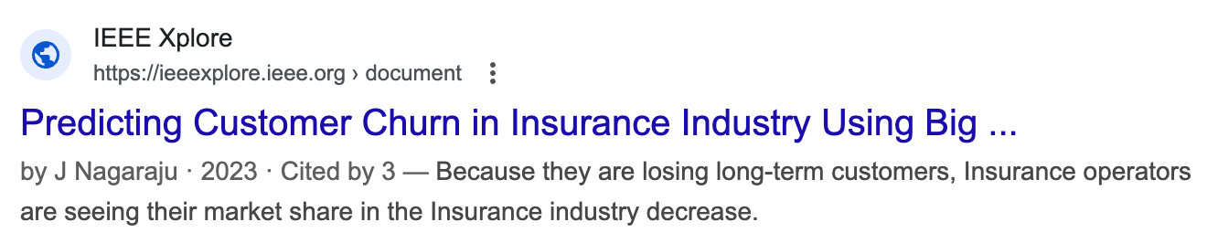
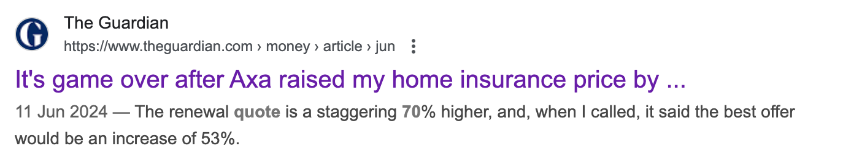
Industry Evidence

Slide 4
What We’re Solving
The Need For insurance companies, renewals are the foundation of consistent revenue and long-term relationships. Securing renewals ensures both financial stability and stronger customer loyalty.
The Challenge Renewal decisions are often uncertain, influenced by many subtle factors that are hard to anticipate. This unpredictability leads to lost opportunities, declining retention, and weakened trust.
The Approach By applying machine learning to historical patterns, insurers can move from reactive guessing to proactive prediction. This data-driven perspective provides a clearer understanding of renewal behavior.
The Result With reliable predictions, insurers can act early, strengthen engagement, and improve overall retention. This leads to healthier customer relationships and sustainable business growth.

Slide 5
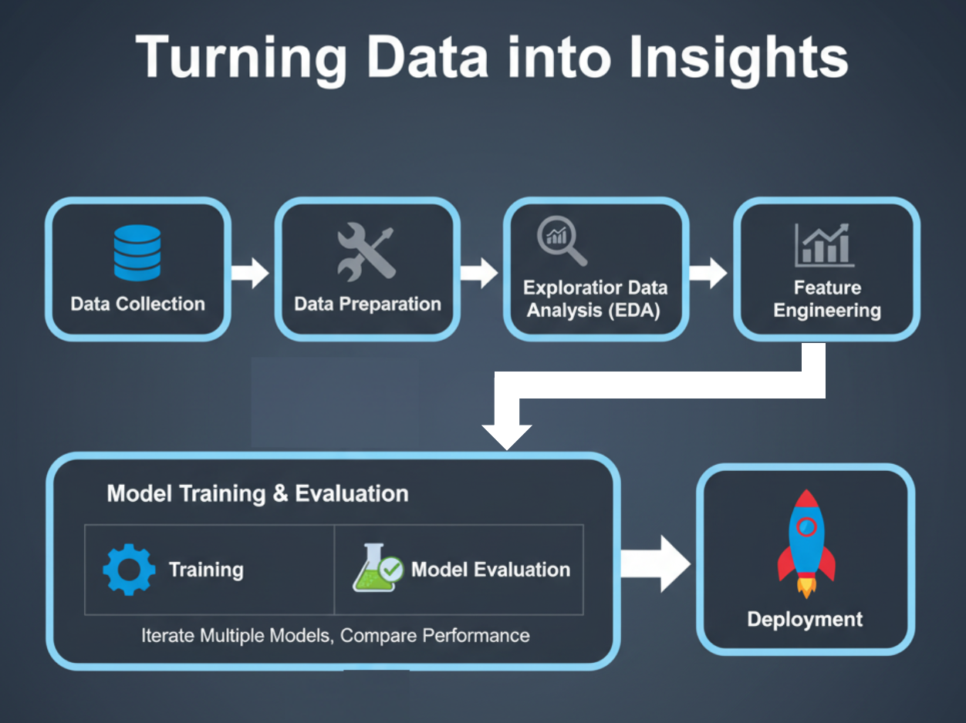

Slide 6
Technical Setup
Operating System – Windows / Mac
Development Environment – Jupyter Notebook (Python)
Libraries Used – scikit-learn, pandas, matplotlib, numpy, seaborn, imblearn
Dataset Source – Kaggle: Insurance Renewal Prediction (LazyPredict)
Dataset Type – CSV flat file (~80k records, mix of numeric & categorical features)
Version Control – GitHub repository: PredictMyPolicy

Slide 7
Influencing Factors
Category | Features | Dtype
Customer Demographics | age_in_days, Income | Numeric
Payment Behavior | perc_premium_paid_by_cash_credit, Count_3-6_months_late, Count_6-12_months_late, Count_more_than_12_months_late, no_of_premiums_paid | Numeric
Risk & Underwriting Factors | application_underwriting_score | Numeric
Policy Attributes | premium | Numeric
Distribution & Geography | sourcing_channel, residence_area_type | Categorical
Target Variable | renewal | Binary ( Binary classification problem)

Slide 8
Missing but Important Renewal Factors
Factor | How it Influences Renewal
Claim History | Frequent or large claims may reduce renewal likelihood due to higher perceived risk.
Type of Insurance | Renewal behavior differs across product lines (e.g., health vs. motor vs. life).
Gender & Marital Status | Demographics can shape risk appetite and renewal decisions.
Policy Add-ons & Riders | Extra benefits improve stickiness and increase renewal probability.
Customer Satisfaction | Poor service or unresolved complaints drive non-renewals.
Competitor Switching | Availability of cheaper/better alternatives can cause churn.

Slide 9
Loading and Reading Dataset
Dataset from Kaggle (~80k records)
Identified target variable: Renewal (binary 0/1)
Reviewed feature composition: numeric (age, income, premium, late counts) &
categorical (sourcing channel, residence type)
Performed initial analysis:
Dataset size and structure (~80k records)
Target variable validation (renewal = 0/1)
Feature type verification (numeric & categorical)
Missing values check
Duplicate records check
Invalid or inconsistent values check (e.g., “Urban” vs “Urbn”)

Slide 10
Problems with Dataset
Minimal Feature Set
Dataset has only basic info: income, age, premiums, late payments…
Missing key churn drivers, e.g.:
Policy type
Claim history / claim delays
Complaints / service issues
Cross-sell / loyalty (multiple products)
Severe Class Imbalance
Renewal rate ≈ 93% (non-renewals ≈ 7%)
Model learns to predict renewal always → looks accurate but misses churn
Imbalance weakens predictive power on the segment we care about most (churners)
Business Implication
Current data = demographics + payments only
Lacks core insurance behavior signals and is imbalanced
Together, these issues limit model’s ability to predict churn effectively

Slide 11
Data Preprocessing & Transformation
1. Dropped irrelevant column (id)
The id column is only a unique identifier.
It does not carry any predictive power for renewal.
Keeping it could mislead the model into finding false patterns.
2. Converted age_in_days → age_in_years
Days are too granular and less interpretable.
Years are more meaningful for business understanding (young vs mid-age vs senior).
Helps in creating age groups/buckets if needed (e.g., 20–30, 30–40).
3. One-hot encoding for categorical features (sourcing_channel, residence_area_type)
ML models (like Logistic Regression, XGBoost) need numeric inputs.
One-hot encoding converts categorical variables into binary indicators (0/1).
Preserves information without introducing ordinal bias (e.g., channel A ≠ channel B, but both get their own dummy variable).

Slide 12
Missing Value Analysis
Late Payment Features (Count_3–6m, Count_6–12m, >12m)
Always missing together → suggests systematic missingness, not random.
Likely indicates “no late payments” → imputed with 0.
Since these features are highly predictive, care taken not to remove variance with blanket imputation.
Application Underwriting Score
Continuous risk score influenced by income, premium, age, and number of premiums paid.
Mean/median imputation would distort distribution.
Used KNN imputation to preserve underlying relationships.

Slide 13
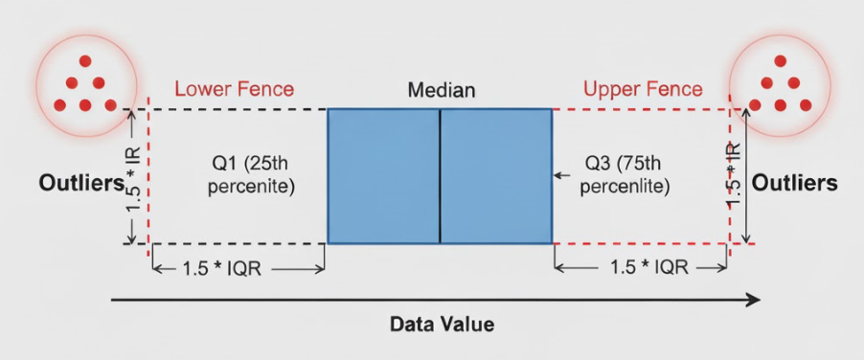
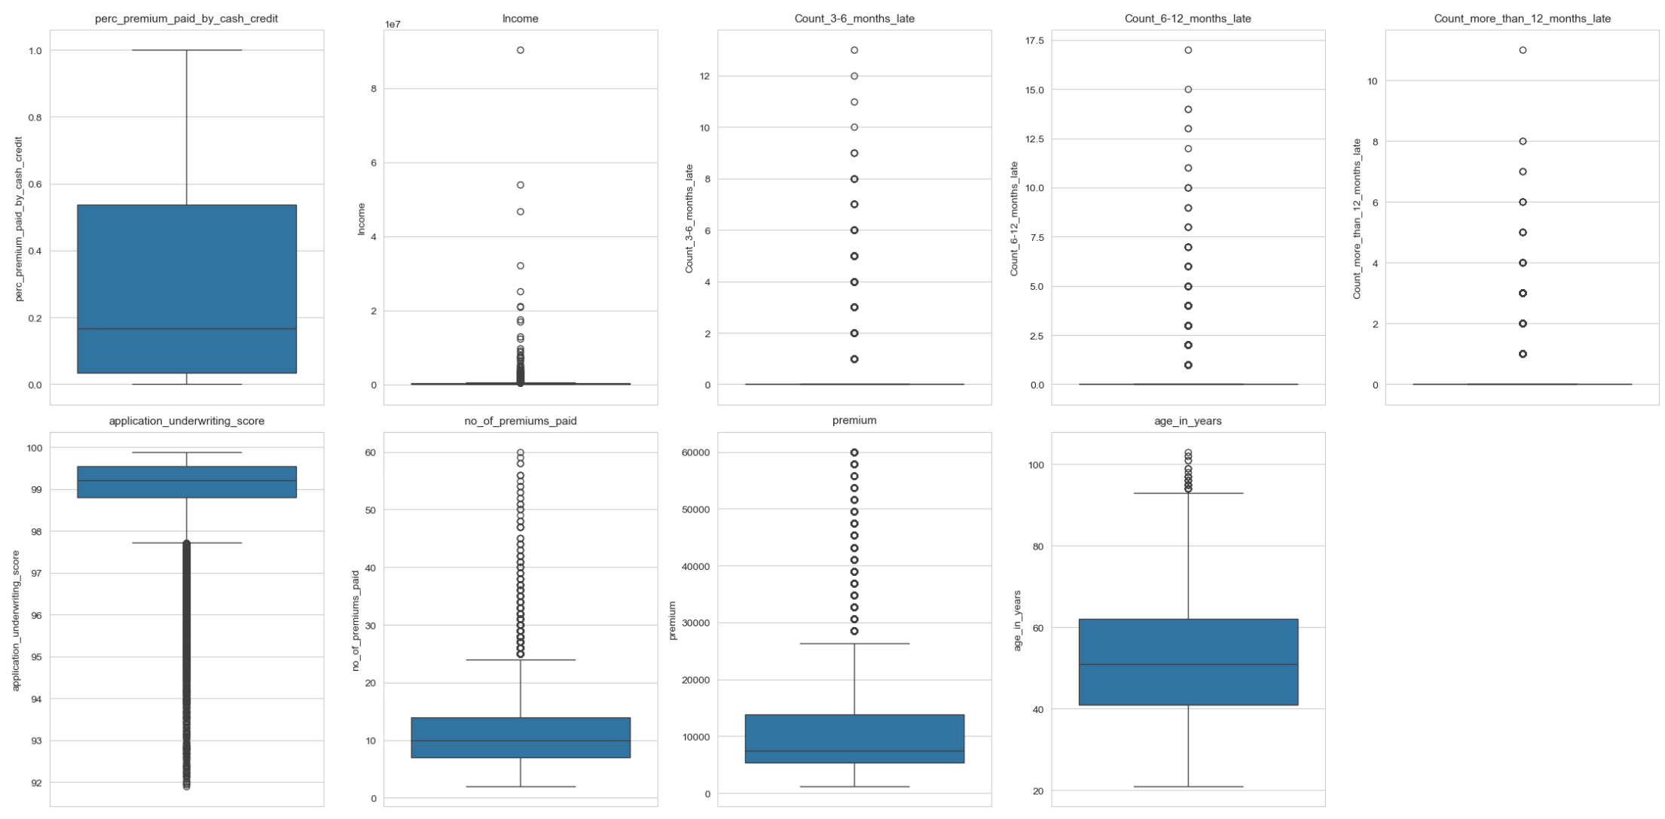
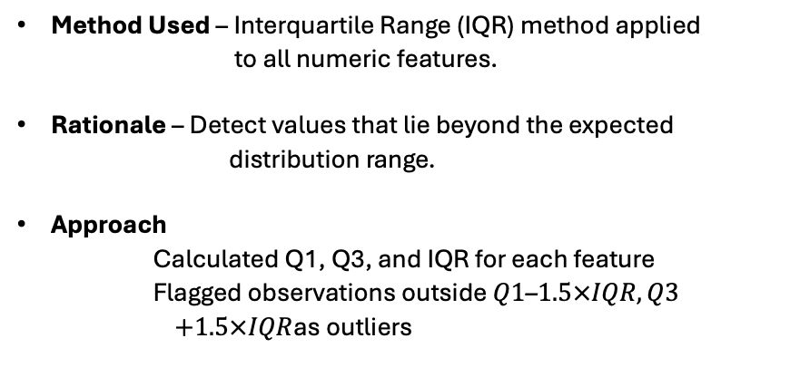
Outlier Analysis
Method Used – Interquartile Range (IQR) method applied
to all numeric features.
Rationale – Detect values that lie beyond the expected
distribution range.
Approach
Calculated Q1, Q3, and IQR for each feature
Flagged observations outside $Q1\text{–}1.5×IQR,Q3$
$+1.5×IQR$as outliers

Slide 14
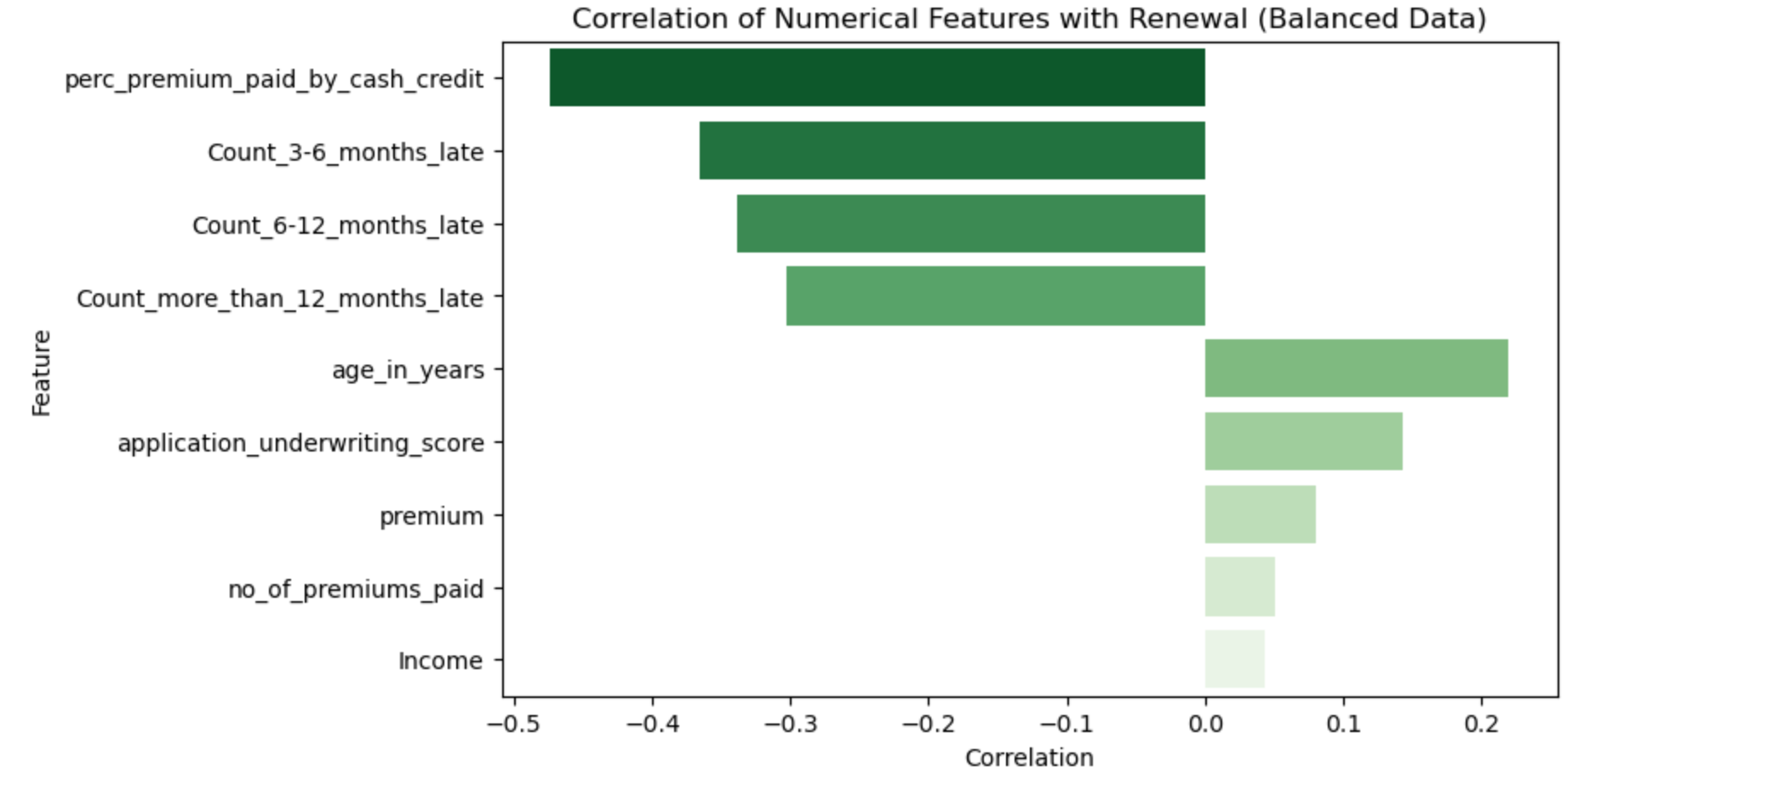
Late Payment Features – Outlier
Distribution
Heavily zero-inflated; most customers have no late payments, smaller subset has positive counts.
IQR Result
Both bounds = 0 → technically flags every positive count as an outlier.
Interpretation
Positive counts are not errors, but valid signals of delinquency.
Strong negative correlation with renewal → critical predictors.
Key Insight
If all missing values were imputed with 0, these columns would collapse to all zeros
effectively erasing the feature.
Correlation analysis shows these features are among the most important.
Decision
Preserve in raw form; retain positive counts; avoid blanket zero-imputation.

Slide 15
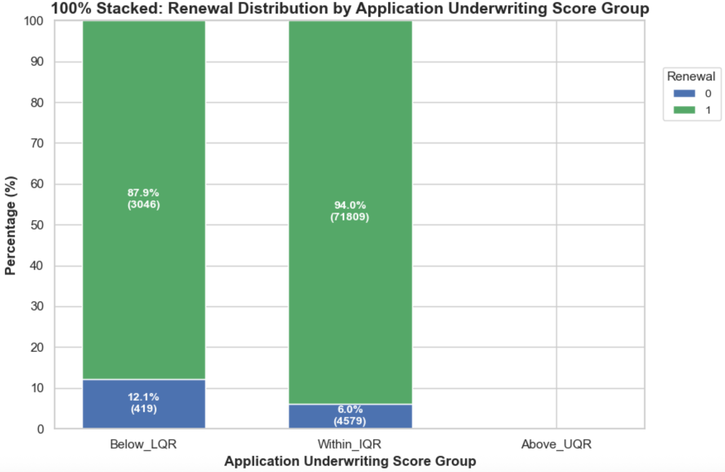
Application Underwriting Score Outliers
IQR Bounds → 97.72 to 100.64
Outliers Detected
3,381 rows (454 distinct values), including values such as 91.9, 91.96, 92.03, etc.
Renewal Rates
Outliers: 87.84% vs Non-outliers: 94.00%
Outliers were 6.16% more likely not to renew
Interpretation
Low underwriting scores reflect higher risk customers
Predictive of non-renewal behavior
Decision
Retained outliers, as they carry strong predictive signal

Slide 16
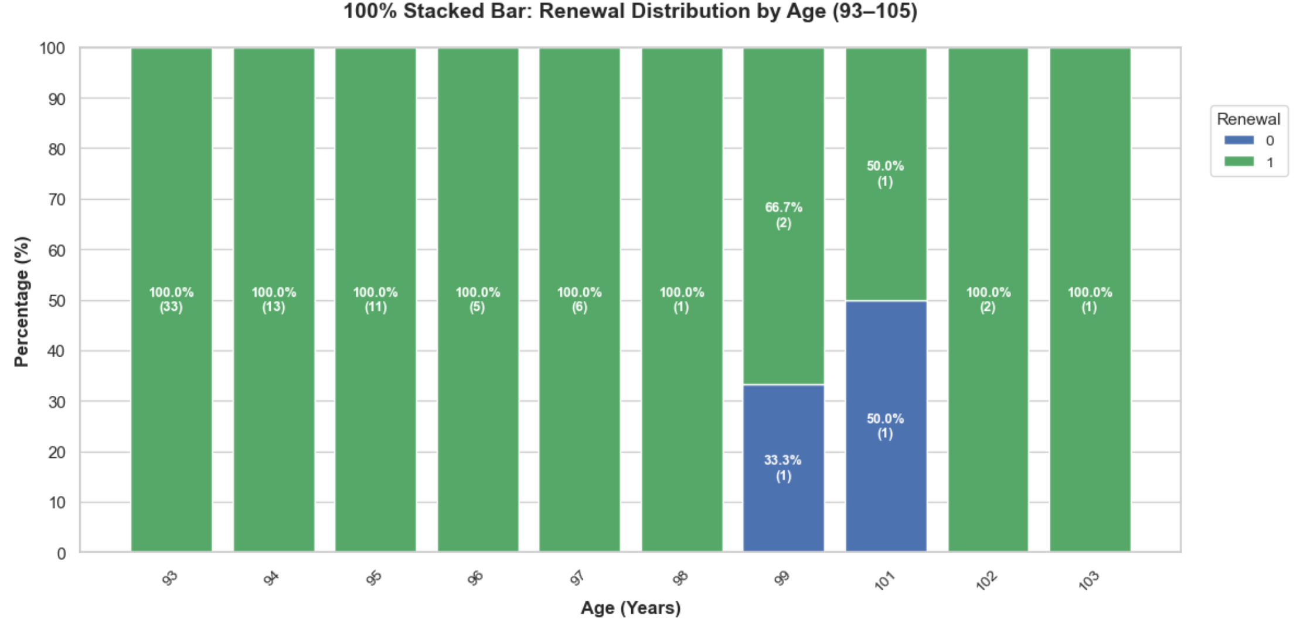
Age Outliers
IQR Upper Bound → 93.5 years
Outliers Detected → 44 records (ages 94–103)
Renewal Rates → Outliers: 95.45% vs Non-outliers: 93.74%
Interpretation →
These are realistic elderly customers, not data errors
Density plot of renewal by age shows older customers are more likely to renew
Renewal rates show no adverse effect → outliers retained
Note →
In real-world insurance, certain policy types may not be offered to very elderly customers
Since policy type is not part of our dataset, we cannot assess this interaction fully

Slide 17
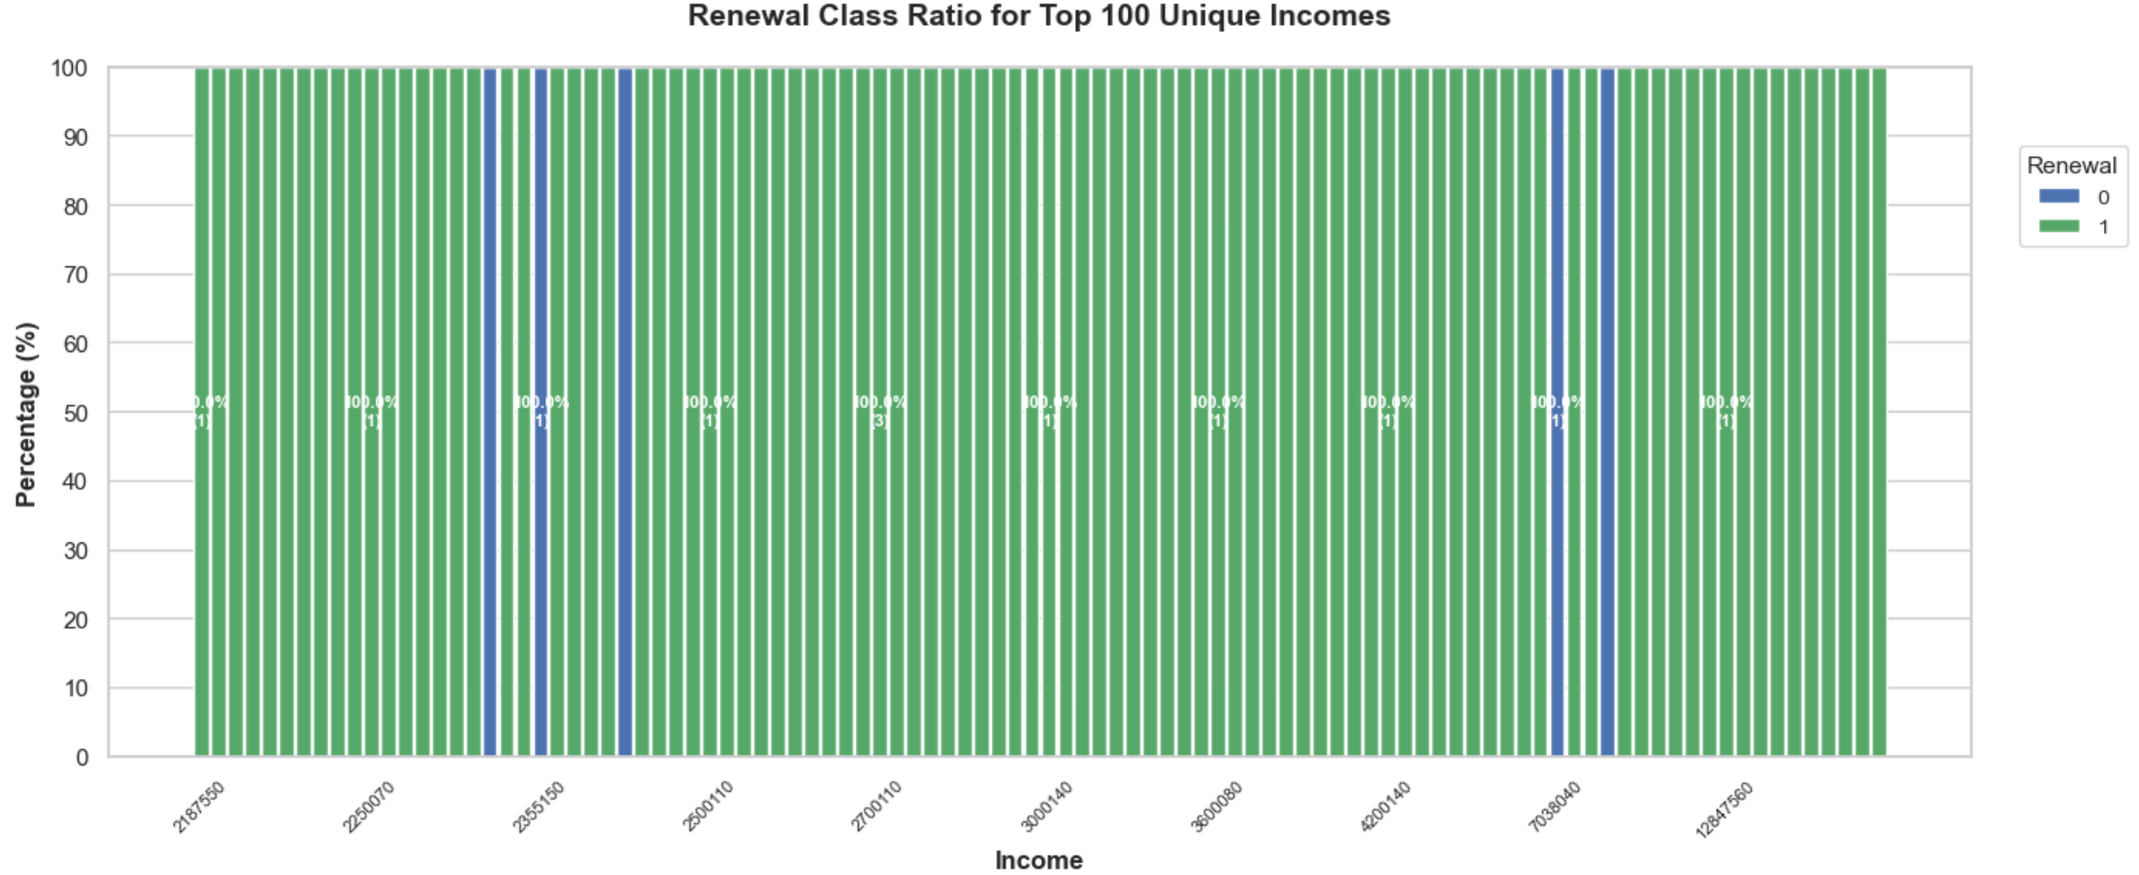
Income Outliers
IQR Bounds → –108,110 to 468,210
Outliers Detected → 3,428 rows (2,233 distinct values) up to 470,040
Renewal Rates → Outliers: 95.22% vs Non-outliers: 93.67%
Interpretation →
Outliers correspond to very high-income customers
High-income customers (right tail) show a stronger renewal tendency compared to lower-income customers.
These customers show higher renewal loyalty
Outliers retained as they are
business-relevant segments

Slide 18
Premium Outliers
IQR Upper Bound → 26,400
Outliers Detected → 4,523 rows (16 distinct values)
Pattern Observed → Structured increments (28,500 → 30,600 → … → 60,000)
Renewal Rates → Outliers: 95.49% vs Non-outliers: 93.64%
Conclusion →
These are valid premium brackets for high-value policies
No adverse impact on renewal → outliers retained

Slide 19
Number of Premiums Paid – Outliers
IQR Upper Bound → 24.5 premiums
Outliers Detected → 1,426 rows (34 distinct values), up to 60 premiums
Renewal Rates → Outliers: 93.13% vs Non-outliers: 93.75%
Interpretation →
Outliers represent long-tenured, loyal policyholders
Renewal behavior is consistent with rest of population
Outliers retained as they provide valuable information

Slide 20
Logical Consistency Checks
Late Payments vs Premiums Paid
242 rows (~0.3%) recorded more late payments than premiums paid
Example: Customer with 2 premiums but 6 late payments
Indicates data recording issues or unrealistic behavior
Premiums Paid vs Age
Some records showed premiums paid greater than customer’s age
Unrealistic under the assumption of yearly premium cycle
Suggests potential anomalies in reporting or data entry

Slide 21
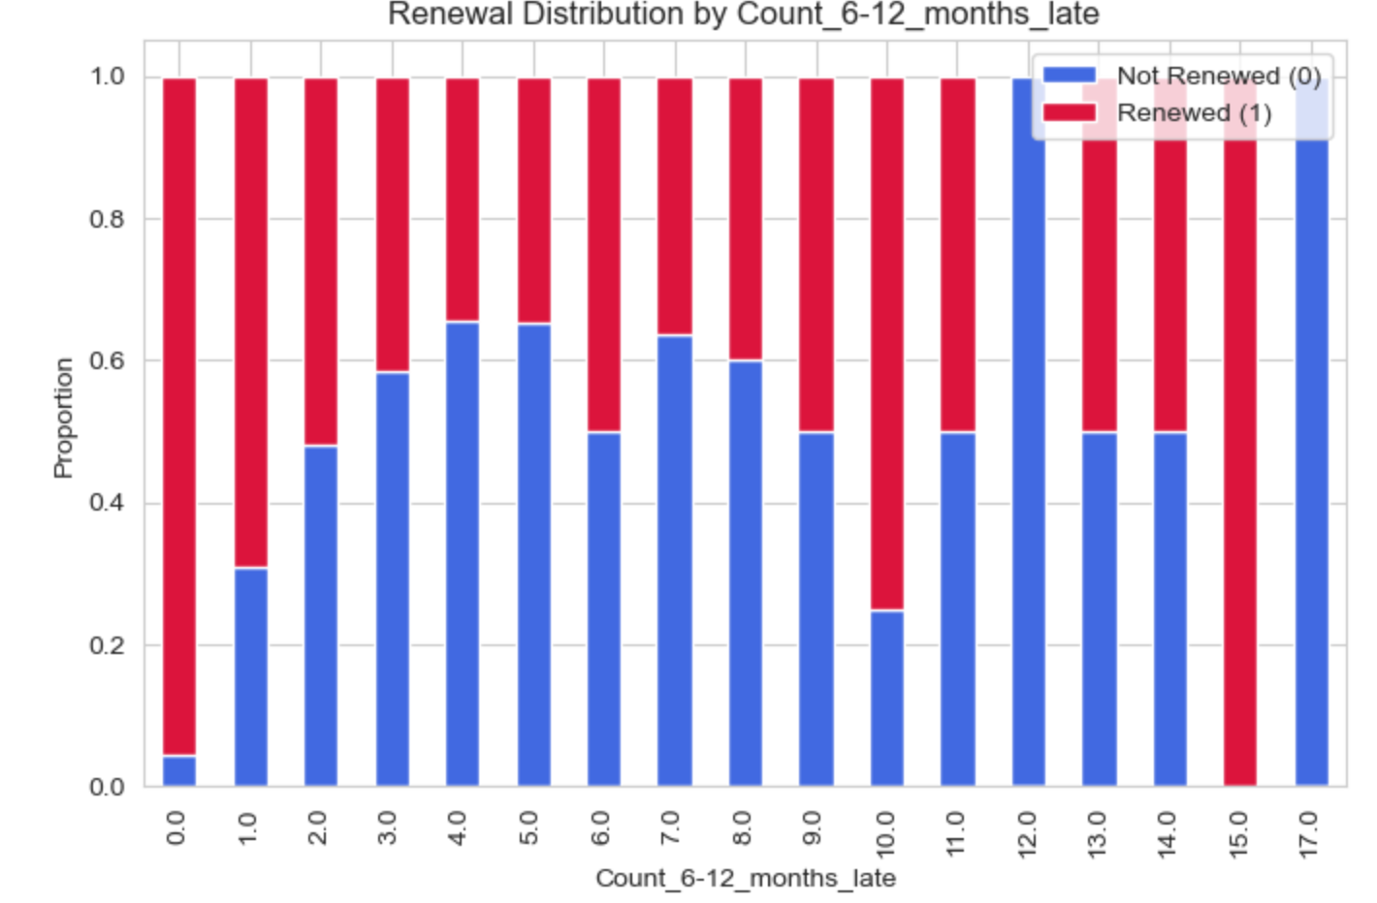
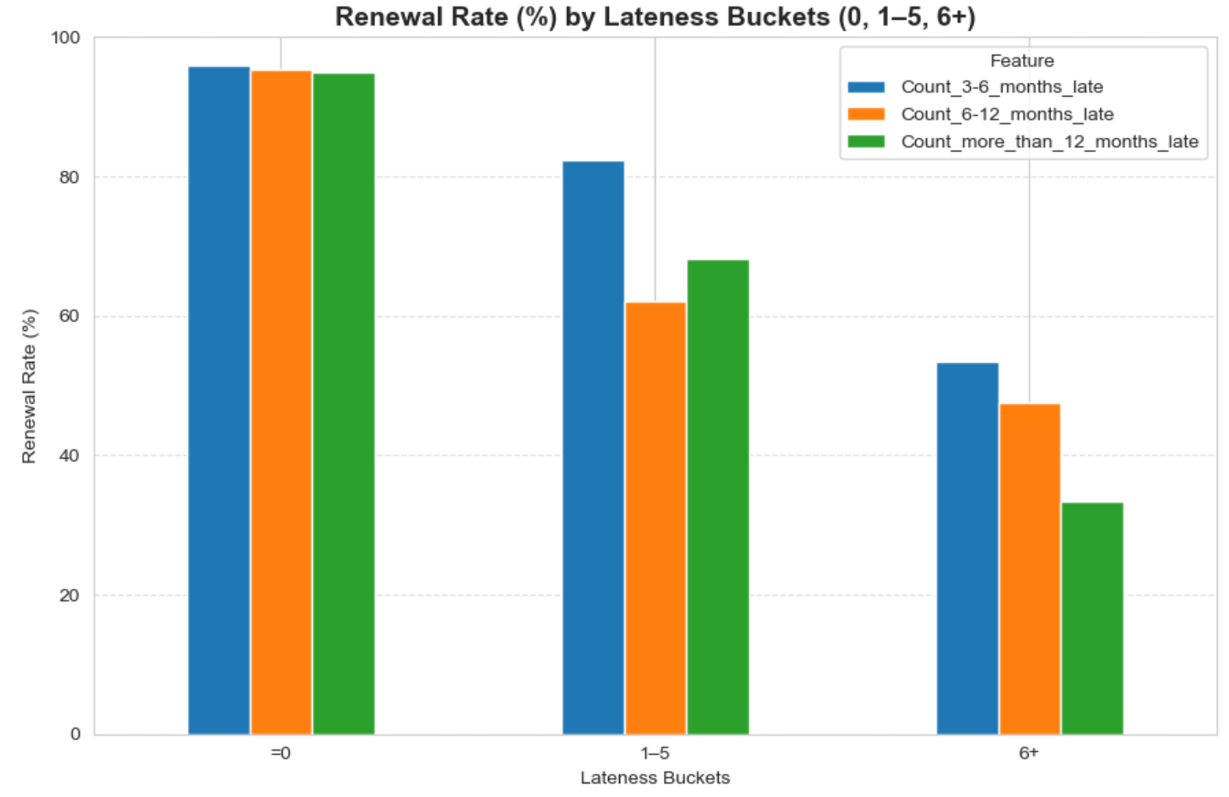
Extreme Late Payment Behavior
183 customers (~0.23%) had ≥6 late payments across any lateness bucket
Out of these:
92 renewed (50.3%)
91 did not renew (49.7%)
Renewal rate ≈ 50%, unlike the population average of ~95%
Such cases behave like noise/random, not consistent patterns
For churn modeling:
Removing 92 renewed records (~0.12%) improves clarity
Treating ≥6 late payments as high churn risk is logical and business-aligned
KNN Neighbor Analysis (excluding lateness & target):
For these extreme renewed cases, the average neighbor lateness < 0.5
Confirms they are very different from their peer group
Strengthens the case that these records are anomalies

Slide 22

Exploratory Data Analysis (EDA)
Having addressed data quality and logical consistency,
We now focus on exploring patterns, distributions, correlations, and feature relationships
Aim → uncover signals that explain renewal vs non-renewal

Slide 23
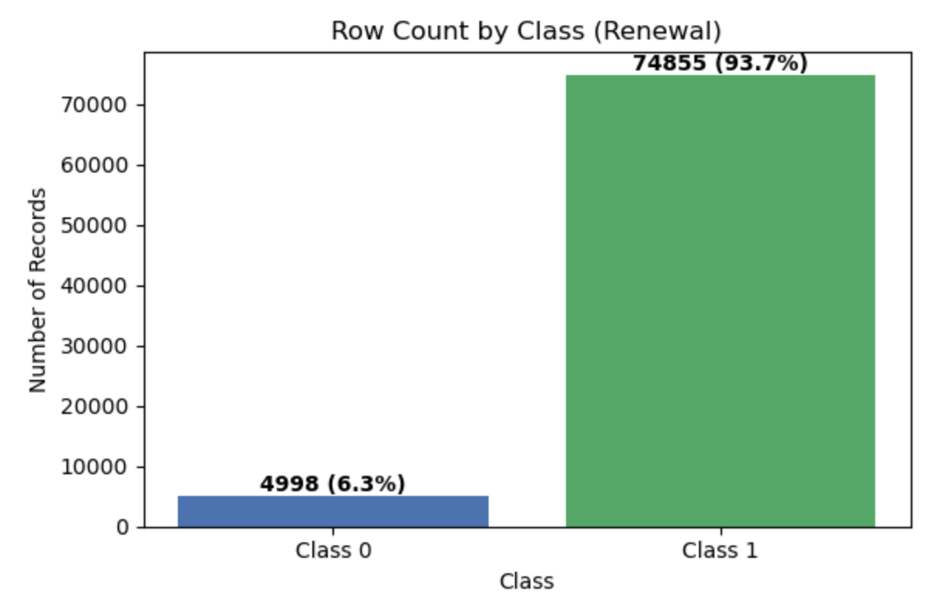
Class Imbalance
Observation → Dataset is highly imbalanced: ~93% renewals vs 7% non-renewals
Risk → Training directly would bias models toward the majority class (renewals)
Mitigation Strategies
Tree-based models → Used class weights to counter imbalance
Statistical models
Applied SMOTE/ADASYN oversampling to generate synthetic minority samples
Evaluation Metrics
Accuracy alone is misleading
Use Balanced Accuracy, F1-score, and PR-AUC to ensure performance reflects minority class capture

Slide 24
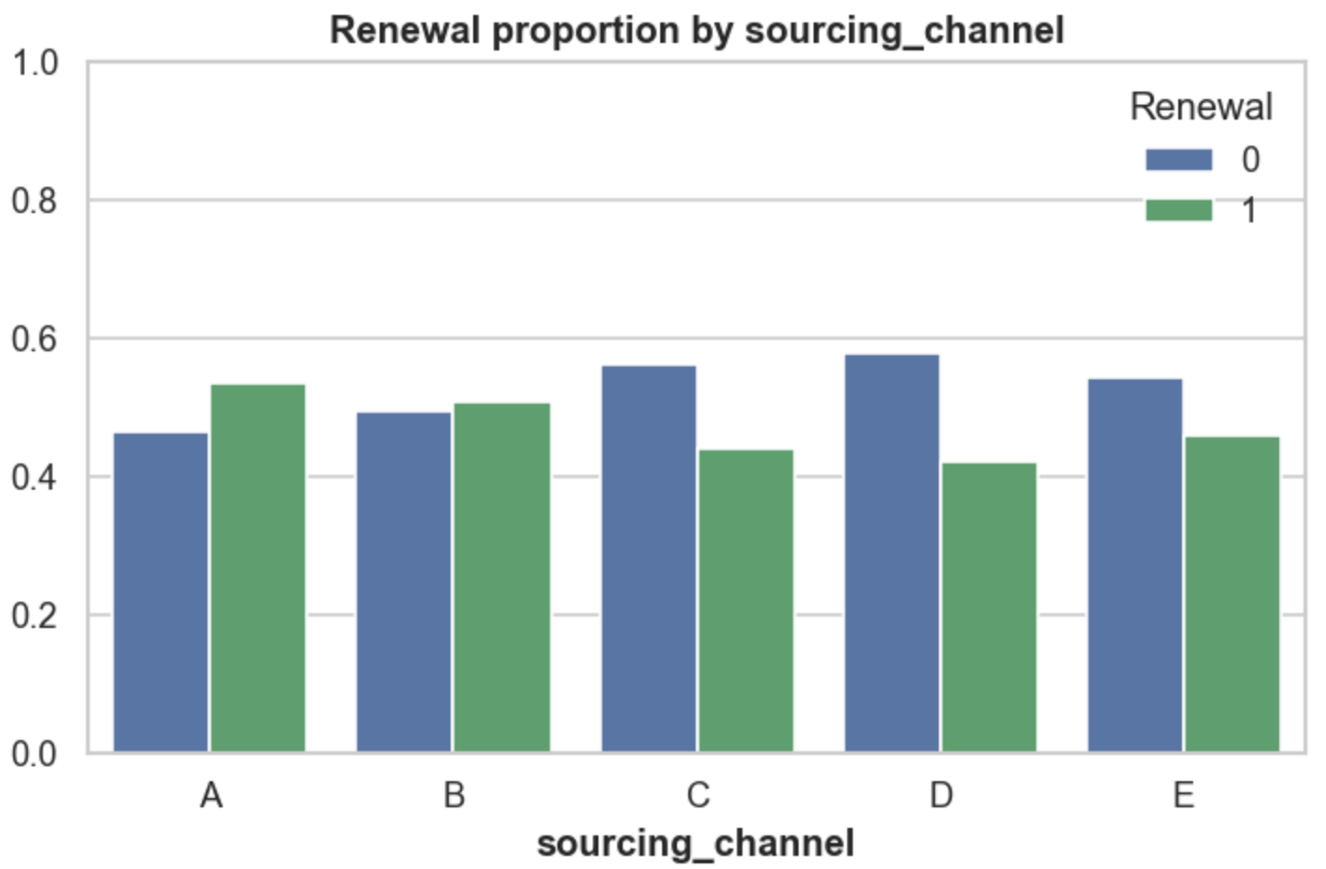
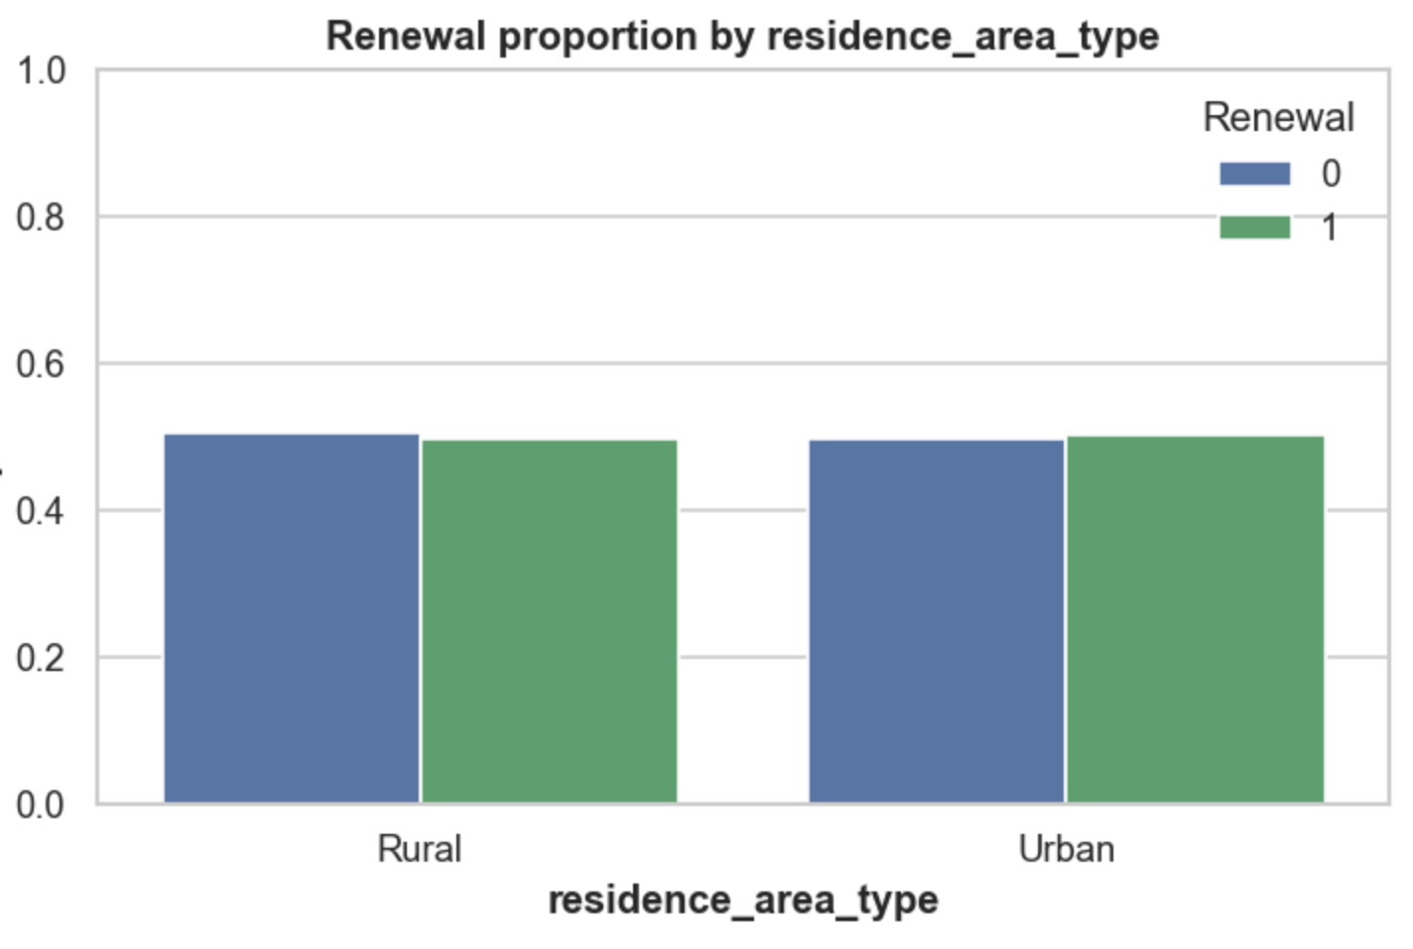
Residence Area Type and sourcing channels
Exploratory Analysis
Renewal rates nearly identical for Urban vs Rural customers
Suggests very minimal predictive power
Multivariate Interaction
Tested interactions with premium, age, income, late payments, underwriting score, and sourcing channel
Differences in renewal rates remained negligible (<3%)
Conclusion
Tree-based models → Feature can be retained (automatically down-weighted if weak)
Statistical models → Safe to drop to reduce noise and improve model stability

Slide 25
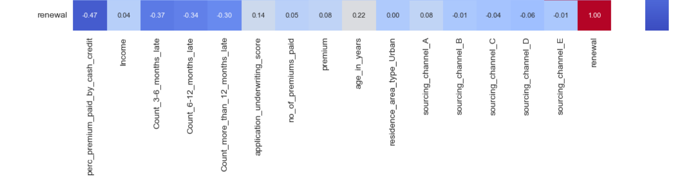
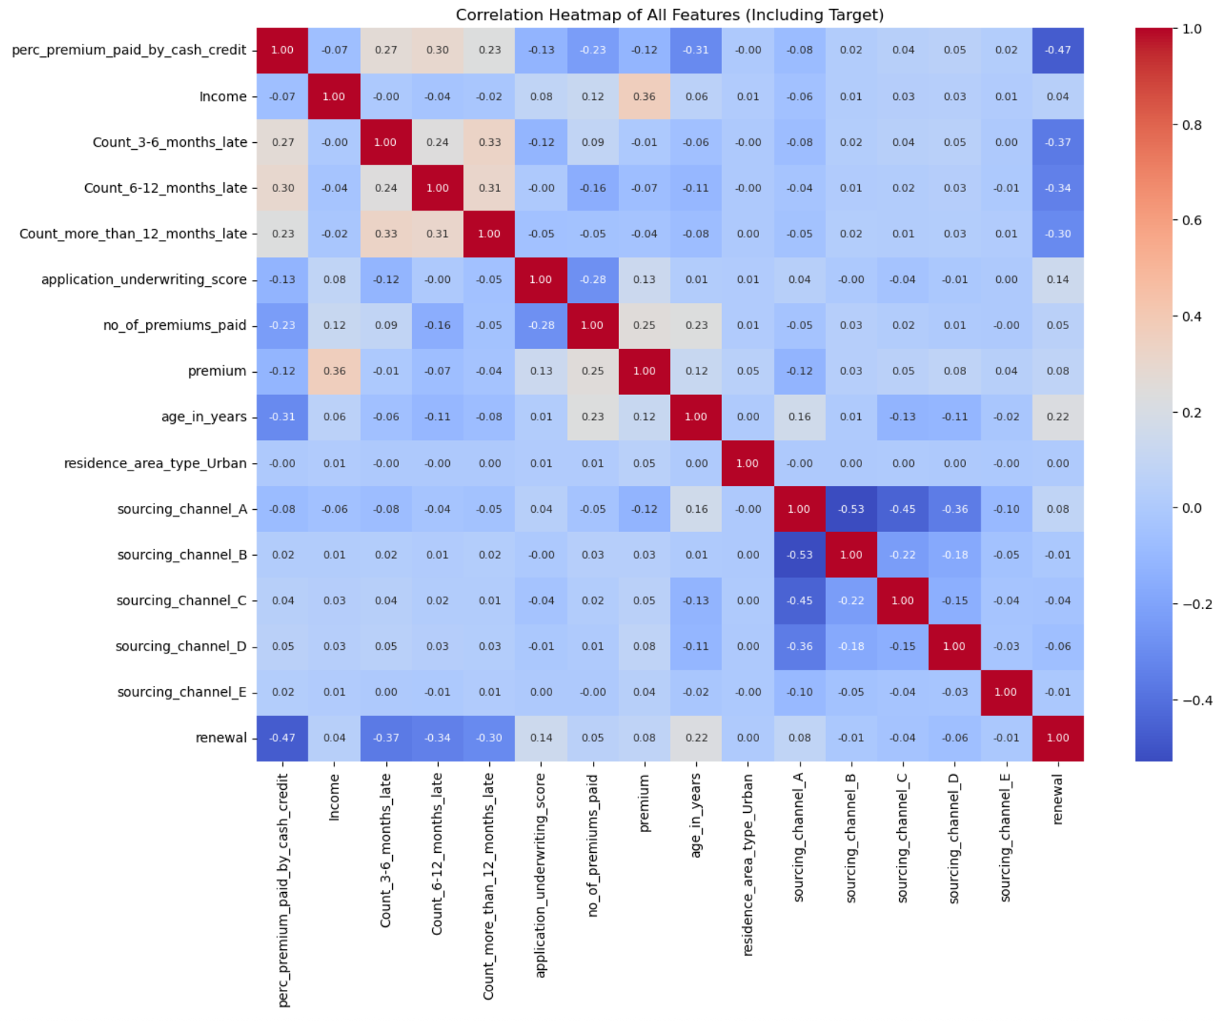
Higher late payment counts → strongly associated with non-renewal

Slide 26
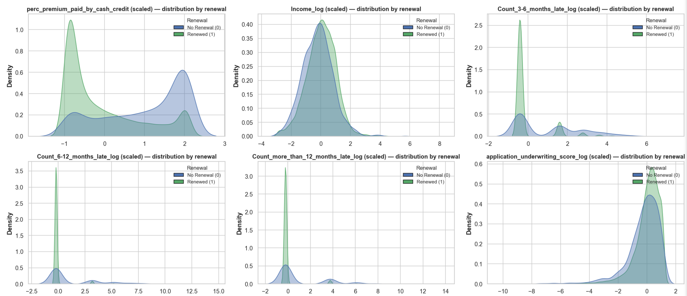
Density Plots
Heavy overlap between renewers and non-renewers across most features
% Premium Paid by Cash/Credit → clearer separation, with non-renewers peaking at higher values

Slide 27
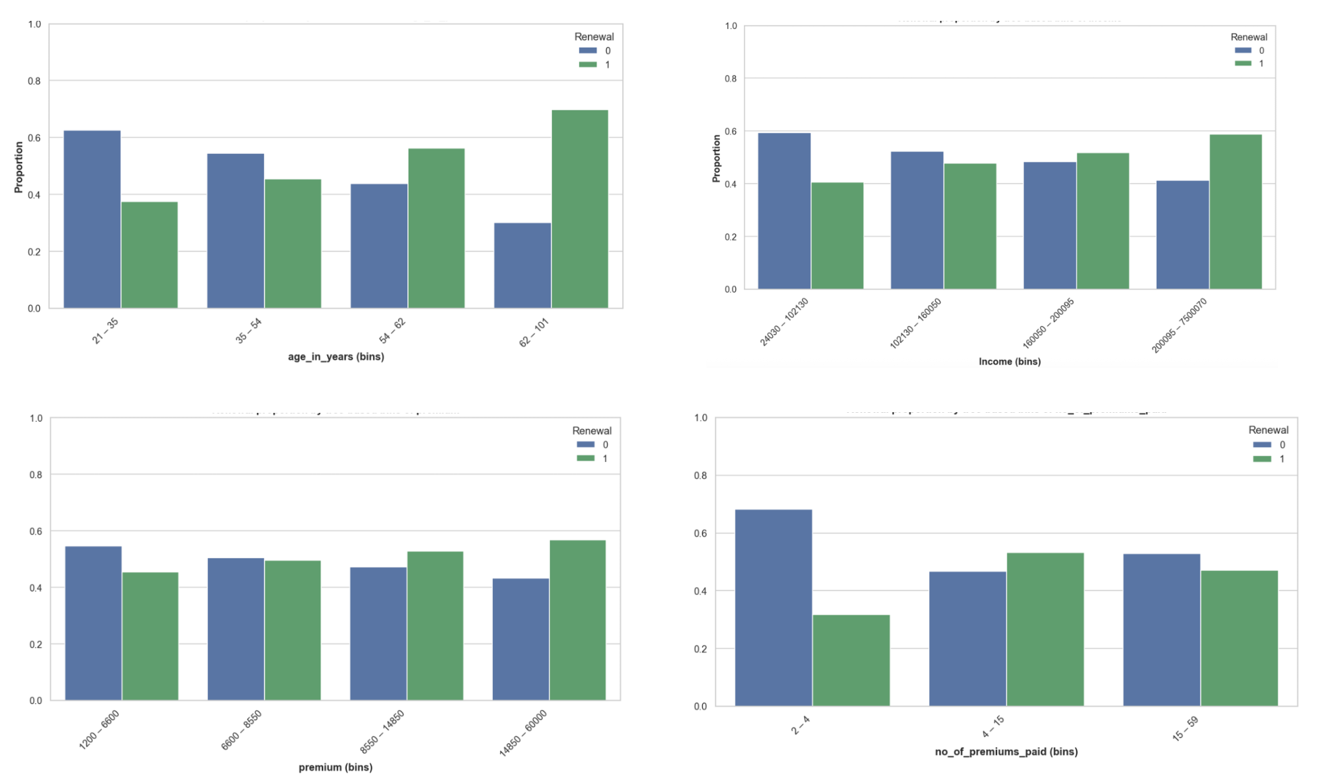
Higher income, more premiums paid, and older age → positively associated with renewal

Slide 28
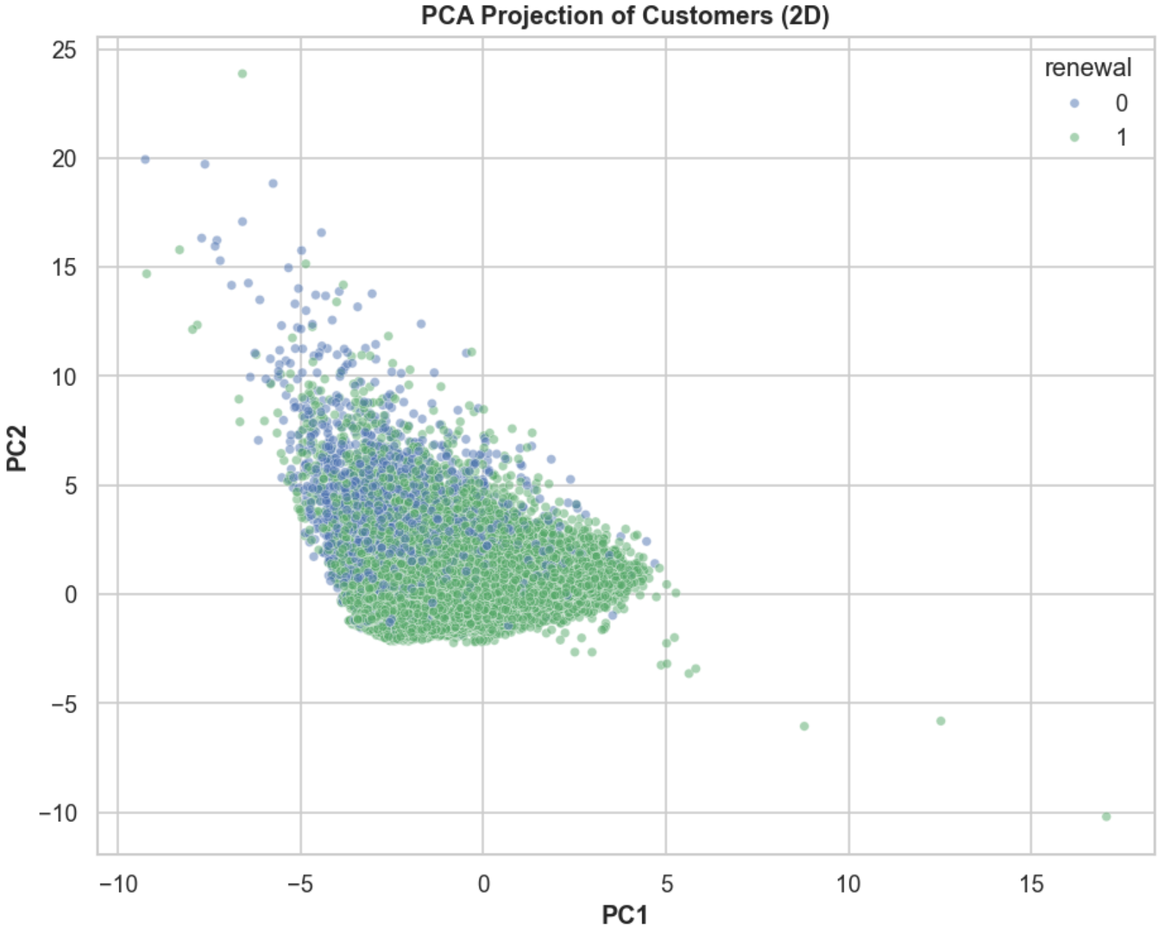
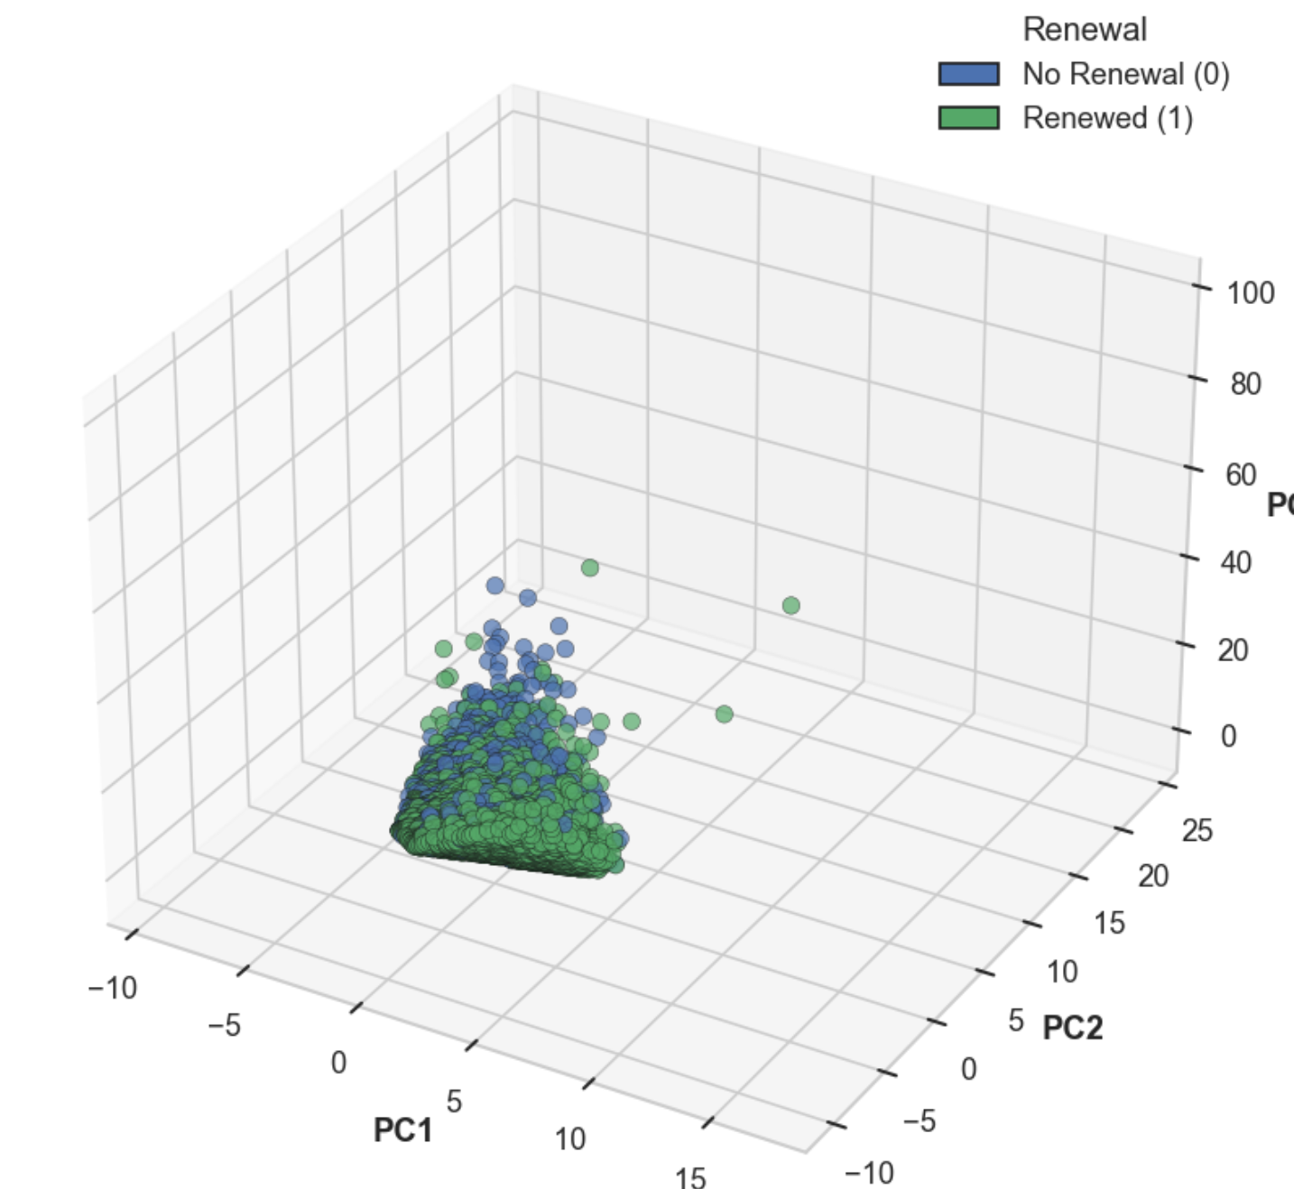
PCA Projection – Customer Renewal
2D & 3D PCA plots show substantial overlap between renewers (1) and non-renewers (0).
Indicates that dominant variance directions in the data do not cleanly separate the classes.
Renewal behavior is driven by complex, non-linear feature interactions, not simple variance.
Implication
Linear models relying only on variance (e.g., plain Logistic Regression without interactions) may underperform.
Tree-based ensembles (Random Forest, XGBoost, Gradient Boosting)
and other non-linear algorithms are better suited to capture these interactions.

Slide 29
Overall EDA Conclusions
Class Imbalance → 93% renewals vs 7% non-renewals; requires resampling/weighting
Feature Correlations →
Negative: % Premium Paid by Cash/Credit, Late Payments
Positive: Age, Underwriting Score, Premium
No single dominant predictor → predictive strength from combined weak signals
Categorical Feature (Residence Area Type) → Minimal impact on renewal, low predictive power
Density Plots → Higher income, more premiums, older customers renew more; late payments strongly linked to non-renewal
PCA Visualization → Strong overlap between classes; renewal driven by non-linear feature interactions
Modeling Implication → Tree-based ensembles best suited to capture these relationships

Slide 30

Feature Engineering (Applied)
Transformations Applied
Converted age_in_days → age_in_years for interpretability
One-hot encoding for categorical features (sourcing_channel, residence_area_type)
Normalized continuous features (Income, Premium, Age, Underwriting Score) for scale-sensitive models
Conclusion
These steps made raw data more interpretable and model-friendly
Ensured compatibility with both statistical and tree-based algorithms

Slide 31
Feature Engineering (New derived features)
Premium–Income Related Features
premium_to_income — Ratio of one installment (premium) to income.
total_premium_paid — Total premiums paid to date.
total_premium_to_income — Cumulative premium payments as a proportion of income Conclusion
Feature | Correlation with Renewal | Insight
premium_to_income | –0.01 | No significant relationship; affordability does not influence renewal decisions.
total_premium_paid | +0.02 | Very weak positive relationship; effectively neutral in predictive strength.
total_premium_to_income | ~0.00 | No measurable impact; cumulative payment-to-income ratio is not a renewal driver.

Slide 32
Feature Engineering (New derived features)
Late Payment Related Features
total_late_payments — Total late payments across all time windows (3–6m, 6–12m, >12m).
late_payment_ratio — Proportion of total late payments relative to total premiums paid.
Feature | Correlation with Renewal | Insight
total_late_payments | –0.35 | Moderate negative correlation; more late payments are associated with lower renewal likelihood.
late_payment_ratio | –0.34 | Moderate negative correlation; frequent late payers are less likely to renew their policies.

Slide 33
Modeling Summary
Objective The goal is to build a robust classification model to predict the likelihood of non-renewal (customer churn), enabling insurers to proactively engage at-risk customers and improve retention.
Modeling Approach We are following a consistent pipeline across all models:
Preprocessing and feature engineering (age conversion, one-hot encoding, normalization)
Addressing class imbalance (Class Weights, SMOTE/ADASYN)
Splitting dataset using train_test_split() with stratification to preserve class ratios
Training multiple classifiers: Logistic Regression, Random Forest, XGBoost, SVM, Neural Networks
Evaluating models with metrics suited for imbalance and churn capture
Evaluation Metrics
Accuracy is avoided due to imbalance (~93% renewals vs 7% non-renewals)
Focus is on:
Recall (priority) → to maximize capture of churners (non-renewals)
F1-score → to balance recall & precision
PR-AUC → to ensure robustness under imbalance

Slide 34
Dataset Variants Overview
Dataset | # Features | Insight / Purpose
base_full | 16 | Original feature-engineered dataset used as the baseline before any cleaning or reduction.
clean_full | 16 | Cleaned version of base_full with invalid/inconsistent records removed to improve data reliability.
base_reduced | 12 | Low-correlation engineered features removed to reduce dimensional complexity while preserving key signal.
clean_reduced | 12 | Combines data cleaning and feature reduction to improve dataset consistency and signal quality.
base_reduced_no_cat | 10 | Categorical variables with minimal predictive value removed to analyze performance impact without weak categorical signals.
clean_reduced_no_cat | 10 | Cleaned version ensuring only meaningful numeric and categorical features remain.

Slide 35
Dataset Variants Overview
Dataset | # Features | Insight / Purpose
base_reduced_no_cat_raw | 9 | Contains only raw (non-engineered) features after removing low-signal categorical variables — evaluates performance on pure raw feature space.
clean_reduced_no_cat_raw | 9 | Cleaned counterpart of raw-only dataset to isolate effect of data quality on minimal feature space.
base_topcorr_only | 4 | Only highest-correlation predictors retained to test performance with a compact, high-signal feature subset.
clean_topcorr_only | 4 | Cleaned version of the top-correlation dataset representing the smallest but most reliable signal space.

Slide 36
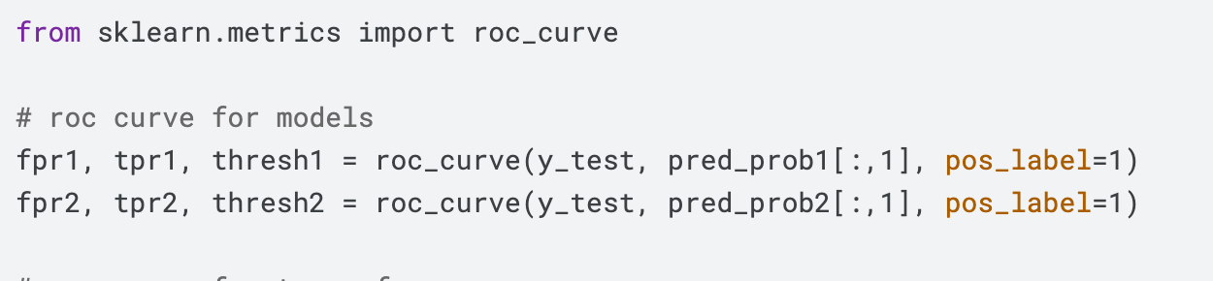
Flipping the Target Label (Non-Renewal as Positive Class)
Why Flip the Label?
The original dataset encoded:
1 = Policy Renewed
0 = Policy Not Renewed (Churn)
But non-renewal is the critical business event we want to detect.
So, the target was flipped to make:
1 = Non-Renewal (Churn / High Risk)
0 = Renewal
Aspect | Before | After (Flipped)
Positive Class Meaning | Renewal | Churn (Business Focus)
Model Focus | Predict stable customers | Identify customers at risk
Interpretation of Recall / Precision / F1 | Confusing | Directly measures churn detection performance
Code / Evaluation | Needs pos_label=0 everywhere | Consistent & clean across all models

Slide 37
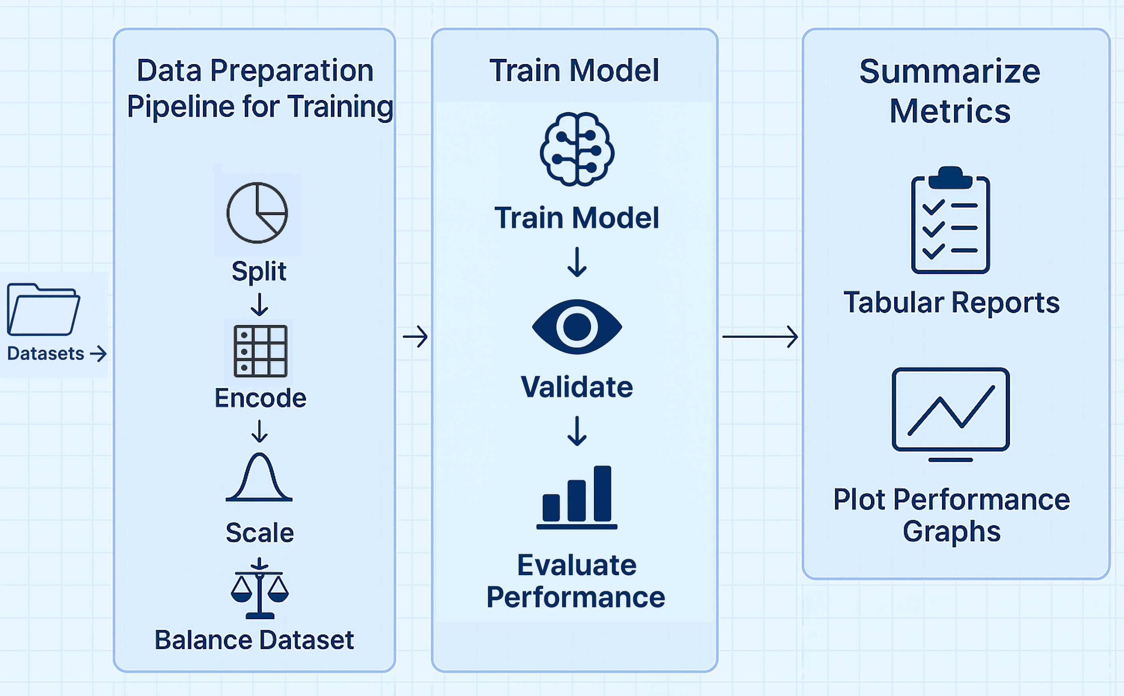
Modeling Workflow Overview

Slide 38
Data Preparation Pipeline
The data preparation pipeline was designed to convert raw policy data into consistent, model-ready input,
while:
Preventing Data Leakage Ensuring no information from validation or test data influences training.
Maintaining a Uniform Workflow Across All Models The exact same preprocessing steps were applied to Logistic Regression,
KNN, SVM, XGBoost, Neural Networks, and Ensemble pipelines for scientific comparability.
Modularized, Reusable Processing Blocks
Each stage (split → encode → scale → resample → train → evaluate)
was implemented as a reusable function, enabling:
Quick switching between dataset versions
Consistent treatment across experiments
Repeatable results across iterations and ensemble stages
Ensuring Fair & Unbiased Evaluation So performance differences reflect true model capability, not preprocessing effects.

Slide 39
Data Preparation Pipeline
Data Preparation Flow (Leakage-Safe)
Dataset Split (First Step Before Any Processing)
We split the dataset into Train / Validation / Test before encoding or scaling.
Only the training set is allowed to influence learned transformations.
Validation and Test are kept untouched until final application. Why: Prevents any statistical signal from the test set leaking into model training, ensuring true generalization.
Categorical Encoding (One-Hot Encoding)
Fit encoder on the training set categories only.
Then transform validation and test using the same category mapping.
Unseen test-time categories are safely handled instead of leaking frequency info.
Why: Ensures category relationships are learned only from training, preventing hidden distribution leakage into model training.

Slide 40
Data Preparation Pipeline
Numerical Feature Scaling (StandardScaler)
Fit scaler on training numeric features (computes training mean & std).
Apply the same scaling parameters to validation and test.
Why: If scaled using full dataset, the model indirectly sees test-set statistics → leakage. This approach ensures fair optimization and stable model convergence.
Handling Class Imbalance (~6% Churn)
Resampling techniques (SMOTE, ADASYN, Undersampling, VAE-based synthesis) are applied only to the training set.
Validation and Test retain their natural imbalance.
Why: If we resample validation or test:
Metrics inflate artificially
Recall/precision lose real-world meaning

Slide 41
Data Preparation Pipeline
Model Training & Threshold Optimization
After training, each model produced probability scores on the validation split.
The pipeline provides flexibility to choose which metric should guide the threshold selection,
using three modular functions:
choose_threshold_for_recall_from_scores()
choose_threshold_for_precision_from_scores()
choose_threshold_max_f1_from_scores()
Models can be evaluated in different decision modes:
Recall-focused evaluation
Precision-focused evaluation
Balanced (F1) evaluation

Slide 42
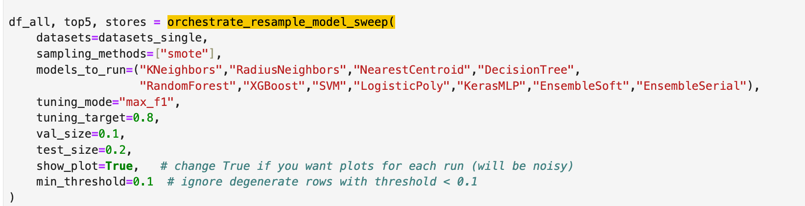
How the Pipeline is Invoked (High-Level Workflow)
A single orchestrator call (orchestrate_resample_model_sweep) runs the full pipeline end-to-end.
For each dataset and model, the pipeline automatically:
Preprocesses the data (Train/Val/Test split → One-Hot Encode → Scale → Resample Train Only)
Trains the model on the prepared training split
Generates validation probabilities and selects the optimal threshold based on the chosen evaluation mode (Recall / Precision / F1 — switchable by parameter, no retraining required)
Applies the selected threshold to the test split for final evaluation
Outputs results into a consolidated results frame → making comparisons easy, consistent, and traceable

Slide 43
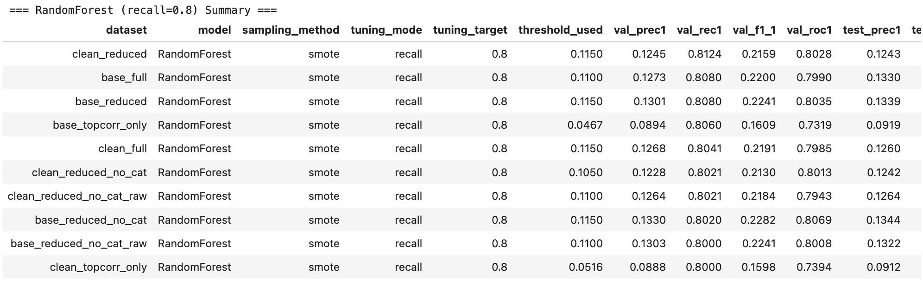
Standardized Model Evaluation Output
This output summarizes the performance of each model + dataset + sampling configuration
after threshold tuning.
Each row reflects one complete experiment setup
Enables fair comparison across different models and dataset variants
Ensures results are reproducible and not dependent on manual adjustments
Helps in identifying the most stable and generalizable configuration for final deployment

Slide 44
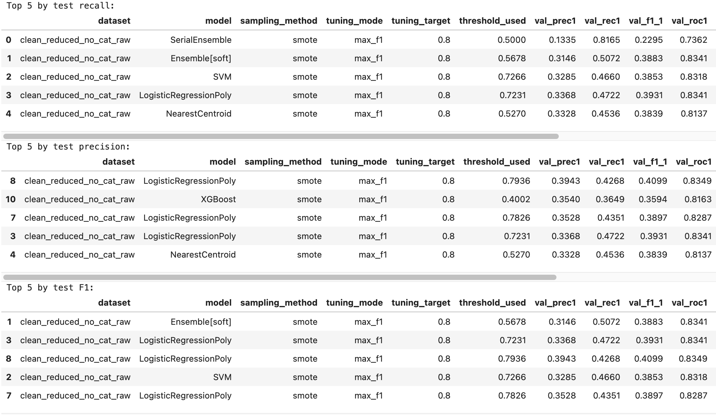
Sample Summary Reports

Slide 45
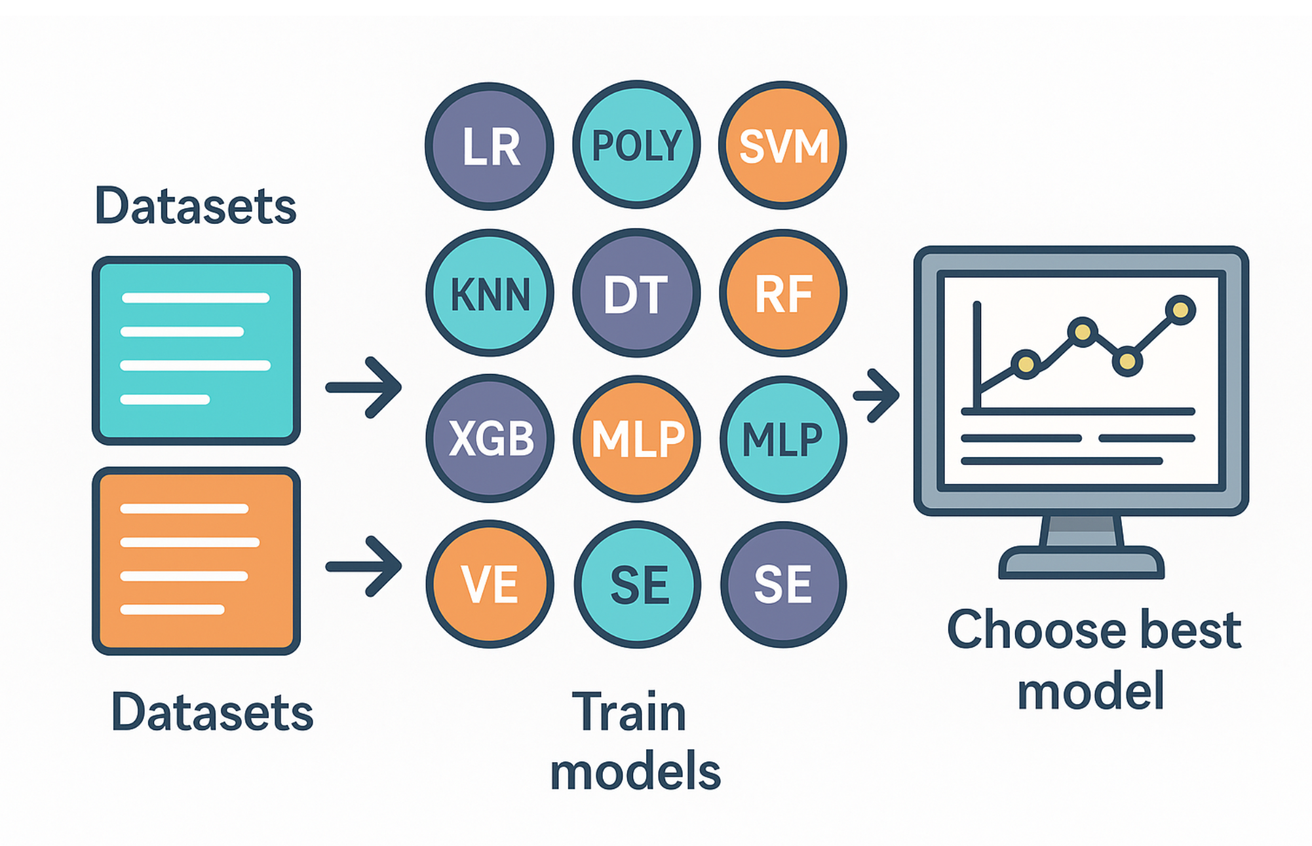
Models Implemented and Tested

Slide 46
Models Implemented and Tested
Linear Models (Baseline Comparisons)
Logistic Regression
Linear baseline classifier modeling log-odds of churn probability.
Interpretable coefficients reveal key renewal drivers.
Regularized with L2 penalty to prevent overfitting.
Hyperparameters Tuned: C, penalty, solver, max_iter.
Balancing Methods: Tried all defined balancing methods from the standardized pipeline.
Polynomial Logistic Regression
Extends Logistic Regression by introducing polynomial feature interactions.
Captures mild nonlinearity while preserving interpretability.
Useful for exploring feature interaction effects.
Hyperparameters Tuned: degree, C, solver, max_iter.
Balancing Methods: Tried all defined balancing methods from the standardized pipeline.
When to Use: When interpretability and explainability are critical; useful as a baseline for comparison against more

Slide 47
Models Implemented and Tested
Margin-Based Models (Support Vector Machines)
Linear SVC (Support Vector Classifier)
Maximizes the separation margin between churn and renewal classes.
Suitable for high-dimensional data; uses class weighting for imbalance.
Hyperparameters Tuned: C, class_weight, penalty, max_iter.
Balancing Methods: Tried all defined balancing methods from the standardized pipeline.
Kernel SVM
Utilizes RBF and polynomial kernels for nonlinear boundaries.
Captures complex decision regions without explicit feature expansion.
Hyperparameters Tuned: C, kernel, gamma, degree, class_weight.
Balancing Methods: Tried all defined balancing methods from the standardized pipeline.
When to Use: Best suited for moderately sized datasets with nonlinear separability where interpretability is less important.

Slide 48
Models Implemented and Tested
Distance-Based Models (Instance-Based Learning)
K-Nearest Neighbors (KNN)
Classifies based on proximity to neighboring samples.
Sensitive to scaling and class imbalance.
Hyperparameters Tuned: n_neighbors, weights, metric, p.
Balancing Methods: Tried all defined balancing methods from the standardized pipeline.
Radius Neighbors Classifier
Considers all points within a specified radius for decision-making.
More adaptive to varying class densities.
Hyperparameters Tuned: radius, weights, metric.
Balancing Methods: Tried all defined balancing methods from the standardized pipeline.
Nearest Centroid Classifier
Assigns samples to the nearest class centroid.
Simple and interpretable; effective for clean, separable data.
Hyperparameters Tuned: metric, shrink_threshold.
Balancing Methods: Tried all defined balancing methods from the standardized pipeline.
When to Use: Effective for small to medium datasets where local structure or neighborhood similarity strongly influences churn behavior.

Slide 49
Models Implemented and Tested
Tree-Based Models (Rule-Based Learners)
Decision Tree Classifier
Splits features recursively based on information gain or Gini reduction.
Simple to interpret but prone to overfitting.
Hyperparameters Tuned: max_depth, criterion, min_samples_split, min_samples_leaf
Balancing Methods: Tried all defined balancing methods from the standardized pipeline.
Random Forest Classifier
Ensemble of randomized decision trees (bagging).
Reduces variance and enhances generalization.
Hyperparameters Tuned: n_estimators, max_depth, max_features, class_weight.
Balancing Methods: Tried all defined balancing methods from the standardized pipeline.
When to Use: Ideal for tabular data with mixed feature types; provides feature importance and interpretable splits.

Slide 50
Models Implemented and Tested
Boosting and Neural Models (Advanced Learners)
XGBoost Classifier
Gradient boosting framework that corrects previous errors sequentially.
Includes built-in imbalance handling via scale_pos_weight.
Hyperparameters Tuned: n_estimators, max_depth, learning_rate, subsample, colsample_bytree, scale_pos_weight.
Balancing Methods: Tried all defined balancing methods from the standardized pipeline.
Neural Network (Multilayer Perceptron – 5 Layers)
Deep feed-forward model capturing nonlinear interactions.
Uses dropout, early stopping, and ReLU activations.
Hyperparameters Tuned: learning_rate, batch_size, epochs, dropout, optimizer.
Balancing Methods: Tried all defined balancing methods from the standardized pipeline.
When to Use: Preferred for large, complex datasets with nonlinear dependencies where maximum predictive performance is desired.

Slide 51
Models Implemented and Tested
Ensemble Models (Model Combination Frameworks)
Voting Ensemble
Parallel combination of multiple base learners.
Aggregates outputs through soft or weighted voting for robustness.
Hyperparameters Tuned: voting_mode, weights.
Balancing Methods: Tried all defined balancing methods from the standardized pipeline.
Serial (Cascade) Ensemble
Sequentially arranges models so each stage handles residual misclassifications.
Improves recall by refining uncertain predictions across stages.
Hyperparameters Tuned: stage_order, threshold_per_stage, sampling_method.
Balancing Methods: Tried all defined balancing methods from the standardized pipeline.
When to Use: Ideal when multiple strong models complement each other — especially in imbalanced datasets requiring higher recall stability.

Slide 52
Dataset Performance Evaluation Overview
Objective:
Evaluate how dataset preprocessing variants (cleaning, feature pruning, category removal) influence model stability and generalization under different tuning strategies.
Setup:
All dataset versions evaluated with identical preprocessing, sampling, and model families.
Tuning modes compared: Recall, Precision, and Max-F1.
Metrics analyzed: Precision, Recall, ROC–AUC.
Purpose:
To identify the most stable, generalizable dataset for downstream training and deployment.

Slide 53
Dataset Performance Summary by Tuning Mode
Tuning Mode | Typical Precision | Typical Recal | Typical ROC–AUC | Key Observations
Recall | ~0.13 | ~0.65 | ~0.80 | Achieved strong recall (expected) but lower precision; stable across all datasets.
Precision | ~0.30 | ~0.30 | ~0.70 | Produced conservative predictions with fewer false positives but lower recall.
F1 | ~0.30–0.40 | ~0.30–0.40 | ~0.80 | Balanced trade-off between recall and precision; moderate discriminative strength.

Slide 54
Dataset-Specific Observations
Distance-Based Models (KNN, Radius Neighbors, Nearest Centroid)
Best performance on topcorr_only datasets.
Correlation-based feature pruning improved distance-based separability.
Reduced feature redundancy minimized distortion in Euclidean/Minkowski space.
Tree-Based and Neural Models
Performed uniformly well across all dataset versions.
Robust to correlated and nonlinear features.
Cleaning/reduction improved training stability, not necessarily accuracy.

Slide 55
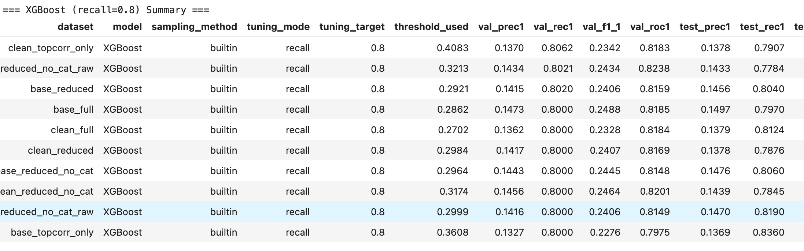
No Single Clear Winner
Observation
Despite experimenting with multiple dataset variants (base, reduced, cleaned, correlation-pruned), no single dataset consistently outperformed the others across all models and tuning modes.
Interpretation
Current feature set has reached a data-driven ceiling — models now learn the same underlying signal, regardless of feature reduction or cleaning choices.
Performance convergence indicates that further gains require richer or external features, such as claim history, customer engagement, or behavioral metrics.

Slide 56
Practical Decision
The dataset clean_reduced_no_cat_raw was chosen as the default reference dataset for all subsequent modeling and deployment.
Reasons for Selection:
Maintains strong recall (~0.8) and stable ROC–AUC (~0.80) across all model families.
Preserves raw numeric structure, ideal for tree-based and neural models.
Removes low-informative categorical fields, simplifying preprocessing.
Offers flexibility for scaling, resampling, and future feature engineering.

Slide 57
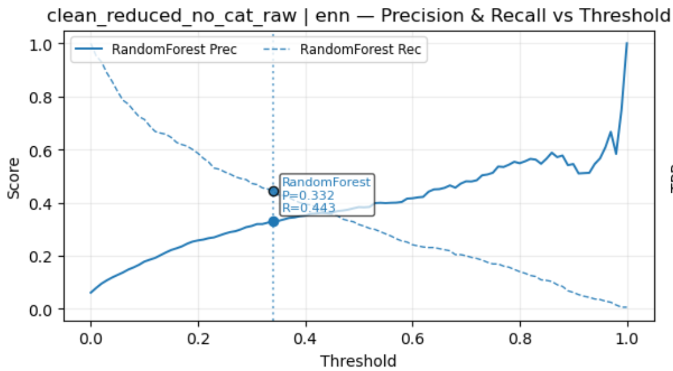
Precision–Recall Trade-off Behavior
Observed Behavior
Precision and recall displayed the expected inverse relationship across all models and resampling methods.
Recall beyond 0.8 caused a sharp drop in precision (~0.15), as models became more permissive to ensure all potential non-renewal cases were captured.
The optimal operating range was typically
between thresholds 0.4–0.6, where:
Precision ≈ 0.35–0.45
Recall ≈ 0.40–0.45
F1 ≈ 0.38–0.40
Interpretation
Since resampling balanced the dataset effectively, this trade-off reflects feature signal limitations, not imbalance.
All model families converged to similar precision–recall curves — suggesting that the current feature set may have reached its predictive ceiling.
Neural and ensemble models provided smoother recall transitions, but even they showed diminishing precision returns at higher recall level

Slide 58
Model Evaluation Summary
Objective
To compare multiple machine learning models, resampling strategies, and tuning configurations on the clean_reduced_no_cat_raw dataset — identifying the most stable recall–precision trade-offs and robust generalization patterns.
Evaluation Setup
All models trained through a standardized pipeline — uniform encoding, scaling, and metric computation.
Balancing Techniques Tested: Random Over/Under-sampling, SMOTE, ADASYN, SMOTE–Tomek, and ENN.
Tuning Strategies:
Max-F1 Mode — balanced optimization of recall and precision.
Recall or Precision Mode — business-driven thresholding for churn sensitivity.
Evaluations performed on consistent train–validation–test splits to ensure fair comparison.

Slide 59
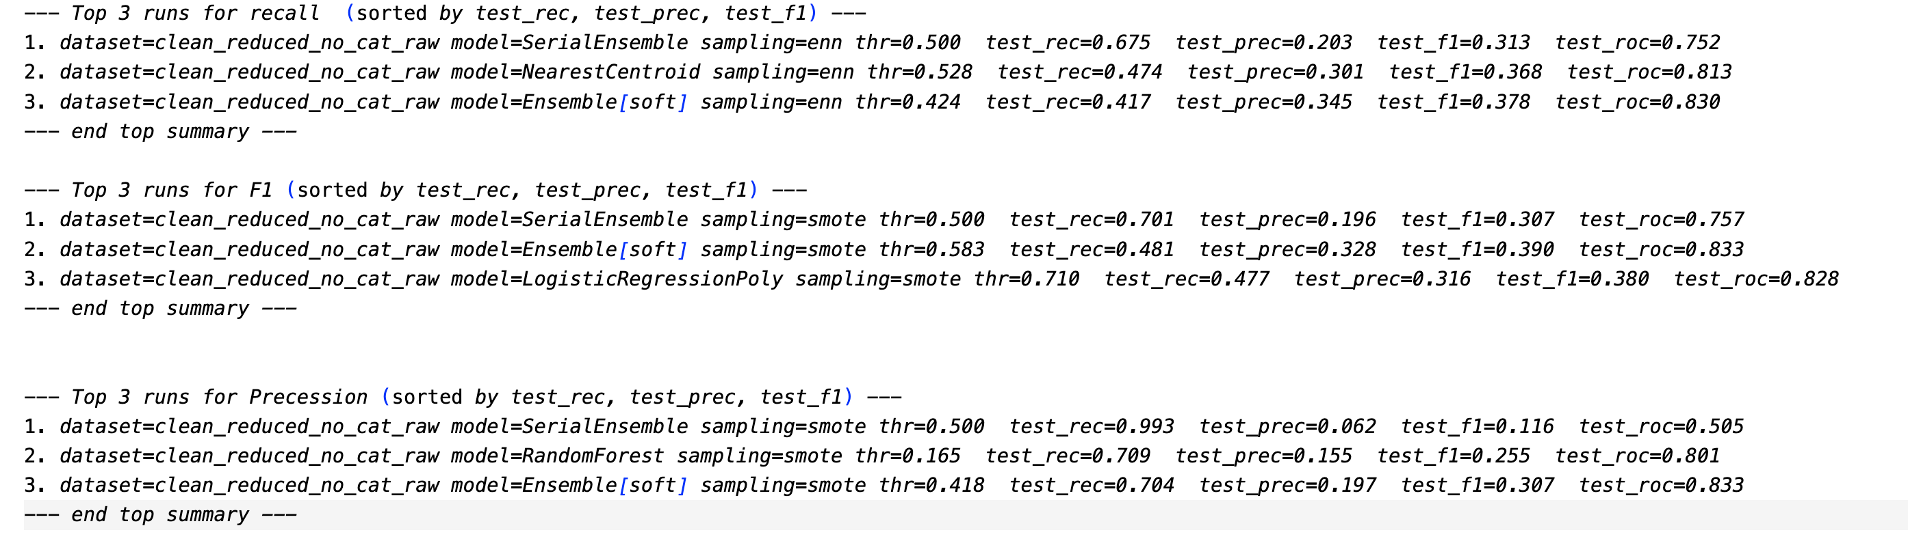
Model Performance Summary
ROC–AUC consistently > 0.70 across models — demonstrating reliable discrimination between renewal and non-renewal.
Stable recall and precision trends across resampling methods indicate a well-calibrated data pipeline.
Minimal performance variance between models confirms strong generalization and effective preprocessing.
The Serial Ensemble model delivered the most balanced and repeatable results across all configurations.

Slide 60
Model Performance Summary
Model | Test Precision | Test Recall | Test F1 | Test ROC–AUC
SerialEnsemble | 0.15 | 0.82 | 0.27 | 0.81
Ensemble[soft] | 0.167 | 0.73 | 0.27 | 0.74
Xgb | 0.17 | 0.71 | 0.27 | 0.81
NearestCentroid | 0.251 | 0.49 | 0.33 | 0.81
LogisticRegressionPoly | 0.32 | 0.45 | 0.37 | 0.82
RandomForest | 0.27 | 0.35 | 0.30 | 0.79
KerasMLP | 0.36 | 0.31 | 0.3388 | 0.7785
DecisionTree | 0.1581 | 0.26 | 0.26 | 0.58

Slide 61
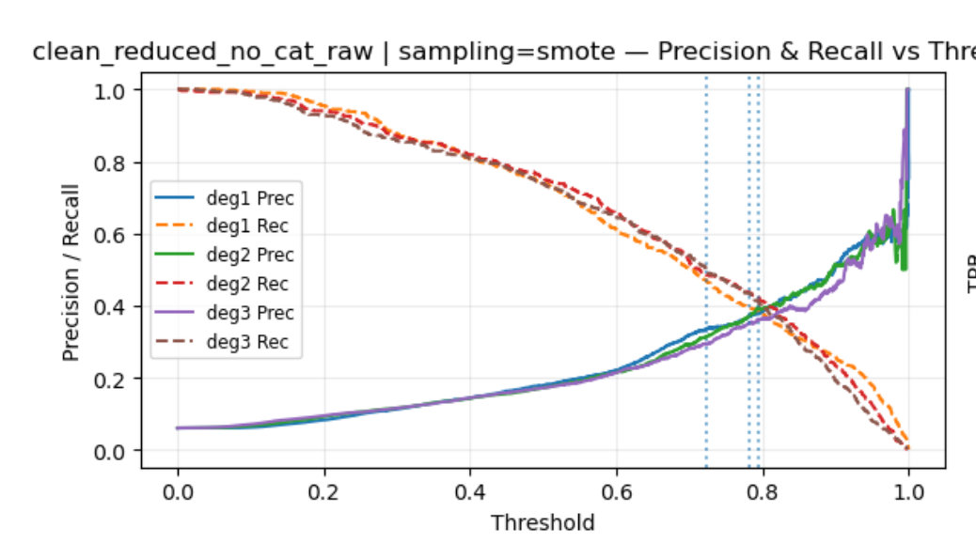
Hyperparameter Tuning and Model Behavior
Overview
Extensive tuning performed across all model families:
Linear models: Regularization strength (C), polynomial degree
Tree-based models: Depth, estimators, learning rate
Neural models: Layers, activation functions, dropout
Tuning improved training stability and reduced overfitting but yielded no major lift in core metrics.
Results
ROC–AUC plateaued at ≈ 0.83–0.84 across algorithms.
Precision and F1-score remained stable despite diverse configurations.
Indicates that models are already extracting the maximum available signal from current features.
.
Interpretation
Further tuning cannot enhance performance meaningfully — the limiting factor lies in feature richness, not algorithm design.
Missing behavioral and transactional features (e.g., claim history, payment consistency, customer engagement) likely constrain predictive power.

Slide 62
Final Summary
Overall Outcome
The clean_reduced_no_cat_raw dataset proved to be the most stable and generalizable foundation for modeling.
All models achieved ROC–AUC > 0.70, confirming consistent and reliable discrimination between renewals and non-renewals.
Serial Ensemble (SMOTE):
Highest recall (~0.81) — best suited for sensitivity-focused use cases.
Consistently captured a greater proportion of true non-renewals without degrading ROC–AUC performance.
Business Alignment
Since the business goal prioritizes recall (identifying potential churners early), the Serial Ensemble configuration was selected as the final model.
The trade-off in precision is acceptable as it minimizes missed high-risk policyholders.

Slide 63
Future Direction
Next-stage improvements will focus on feature enrichment, integrating behavioral and transactional signals such as:
Claim frequency
Payment and renewal patterns
Customer engagement and service interactions
With richer features, the next iteration is expected to raise both recall and precision, improving overall model sensitivity and reliability.

Slide 64
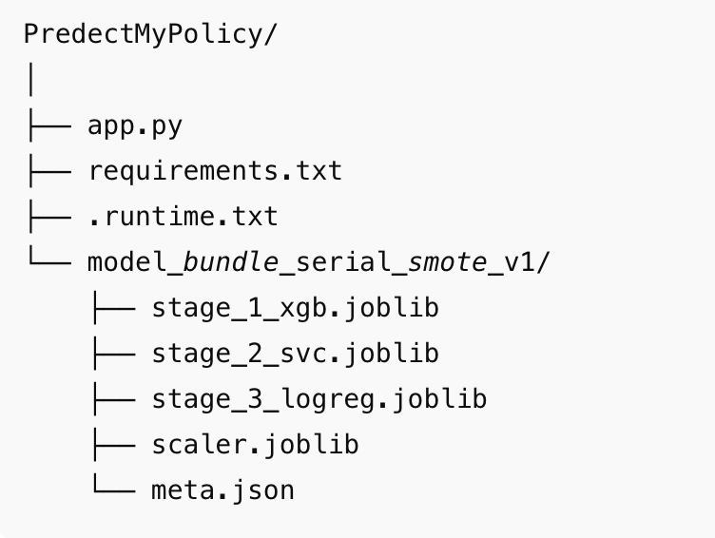
Model Deployment
The final model was deployed as an interactive, production-ready web application using Streamlit.
The web app is publicly accessible here:
Predictmypolicy
This application allows users to predict renewal outcomes for new policyholders without needing any programming knowledge.

Slide 65
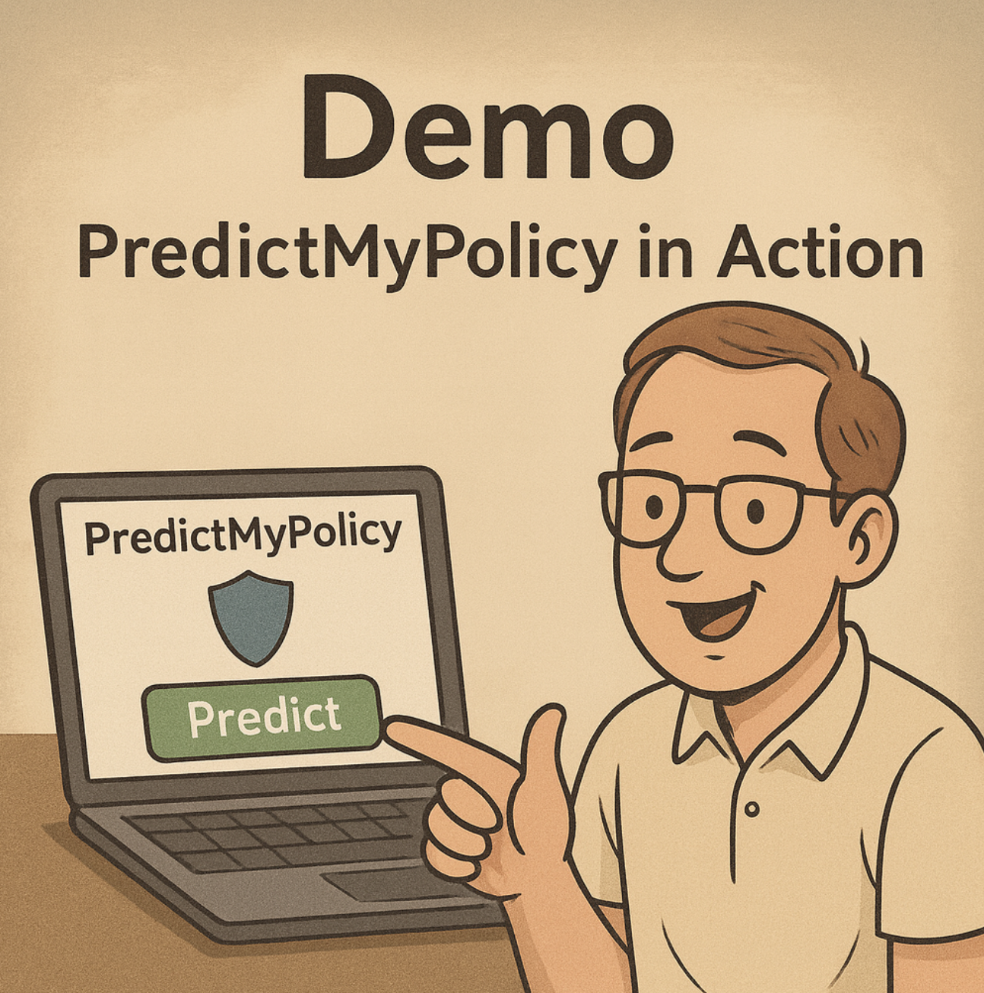

Slide 66
